Slide 1
Peanut Agronomy
David Jordan
Department of Crop and Soil Sciences
North Carolina State University

Slide 2
General Production Practices
Apply nutrients based on soil test (pH 5.8 to 6.2)
Avoid excessive Mg and K
Avoid fields with zinc
Establish good rotations (cotton, corn, sorghum)
Plant improved varieties in May
5 seed per foot of row on 36-inch rows
Conventional tillage
Irrigate if possible
Inoculate with Bradyrhizobia for BNF
Apply calcium at pegging
Apply boron and manganese as needed
Dig and harvest in a timely manner
Control pests using IPM practices

Slide 4
Peanut response to soil pH and gypsum rate.ª
 | Gypsum rate
Soil pH | 0 | 0.5X | 1.0X
 | ________ Percent of maximum yield ________
4.5 | 42 f | 55 e | 55 e
5.2 | 55 e | 56 e | 59 e
5.6 | 78 c | 78 c | 69 d
6.0 | 84 b | 97 a | 95 a
ªData are pooled over 3 years.

Slide 5
Potash Recommendations for Peanuts as Related to Potassium Soil Test Index (K-I), NCDA&CS.*
Soil Test K-I | Potash (K₂O) in lbs/acre
0 | 150
10 | 120
20 | 90
30 | 70
40 | 40
50 | 30
60 | 10
70 | 0
*Crop fertilization based on N.C. soil tests; based on equation 15 for calculating rates of fertilizer https://www.ncagr.gov/agronomi/pdffiles/obook.pdf.

Slide 6
General Production Practices
Apply nutrients based on soil test (pH 5.8 to 6.2)
Avoid excessive Mg and K
Avoid fields with zinc
Establish good rotations (cotton, corn, sorghum)
Plant improved varieties in May
5 seed per foot of row on 36-inch rows
Conventional tillage
Irrigate if possible
Inoculate with Bradyrhizobia for BNF
Apply calcium at pegging
Apply boron and manganese as needed
Dig and harvest in a timely manner
Control pests using IPM practices

Slide 7
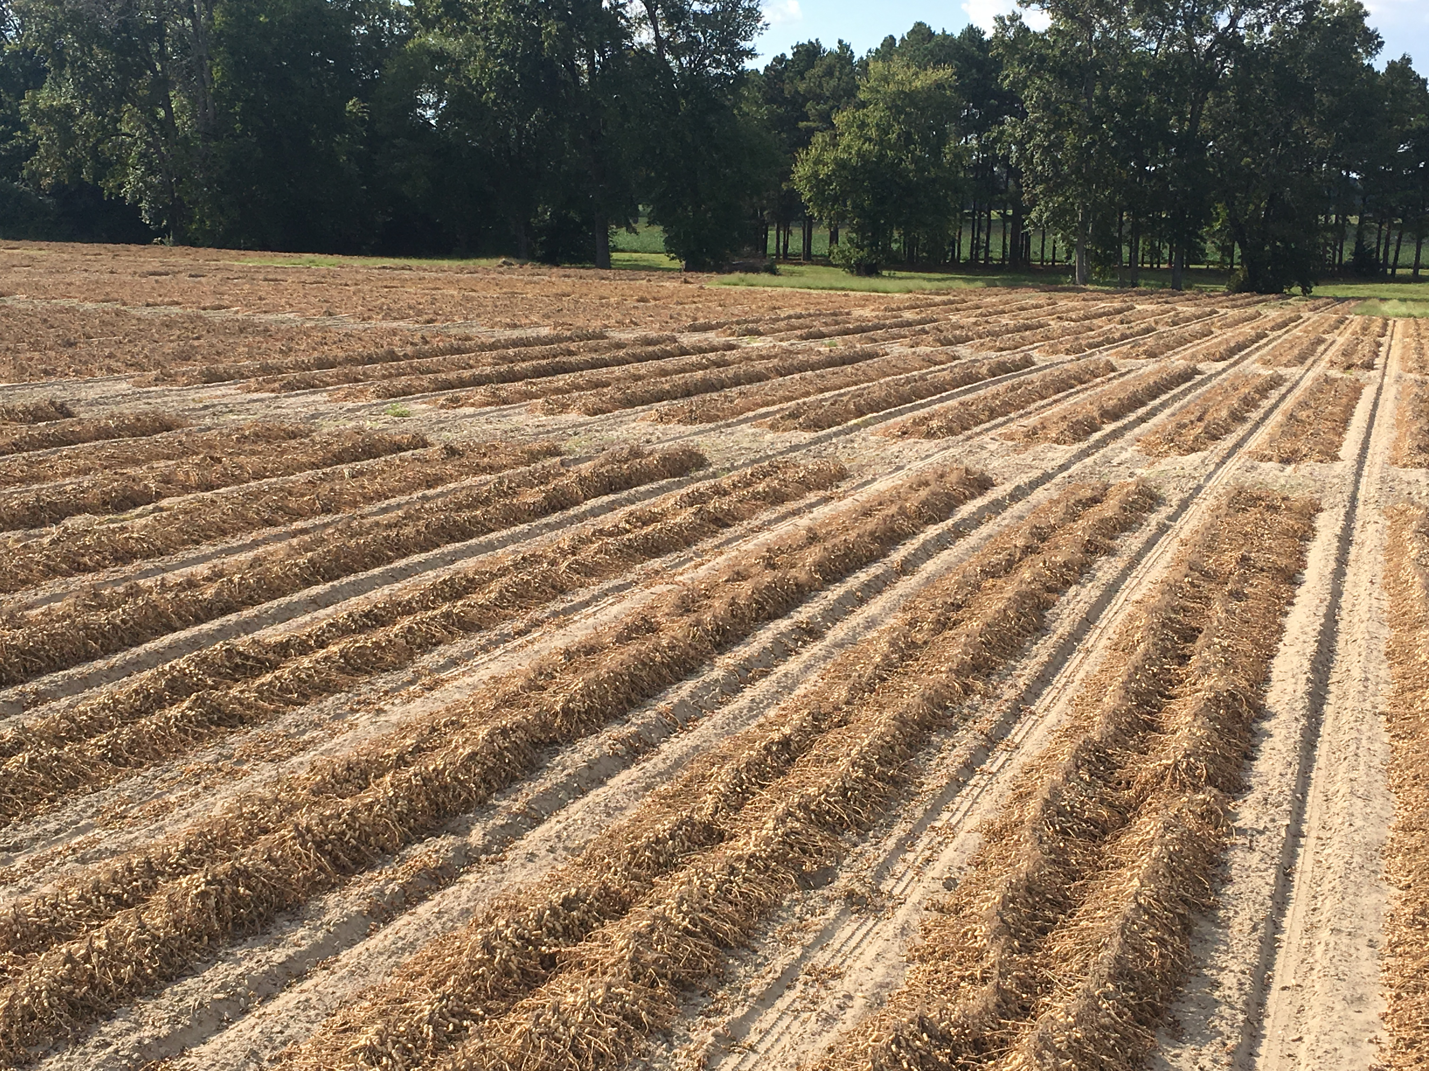

Slide 8
General Production Practices
Apply nutrients based on soil test (pH 5.8 to 6.2)
Avoid excessive Mg and K
Avoid fields with zinc
Establish good rotations (cotton, corn, sorghum)
Plant improved varieties in May
5 seed per foot of row on 36-inch rows
Conventional tillage
Irrigate if possible
Inoculate with Bradyrhizobia for BNF
Apply calcium at pegging
Apply boron and manganese as needed
Dig and harvest in a timely manner
Control pests using IPM practices

Slide 9
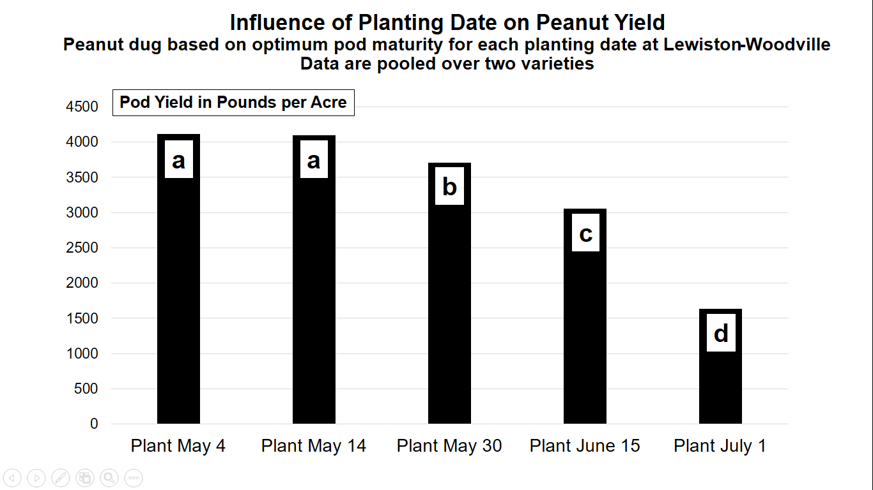
Walton (3,483 lbs/acre) versus Bailey II (3,158 lbs/acre)

Slide 10
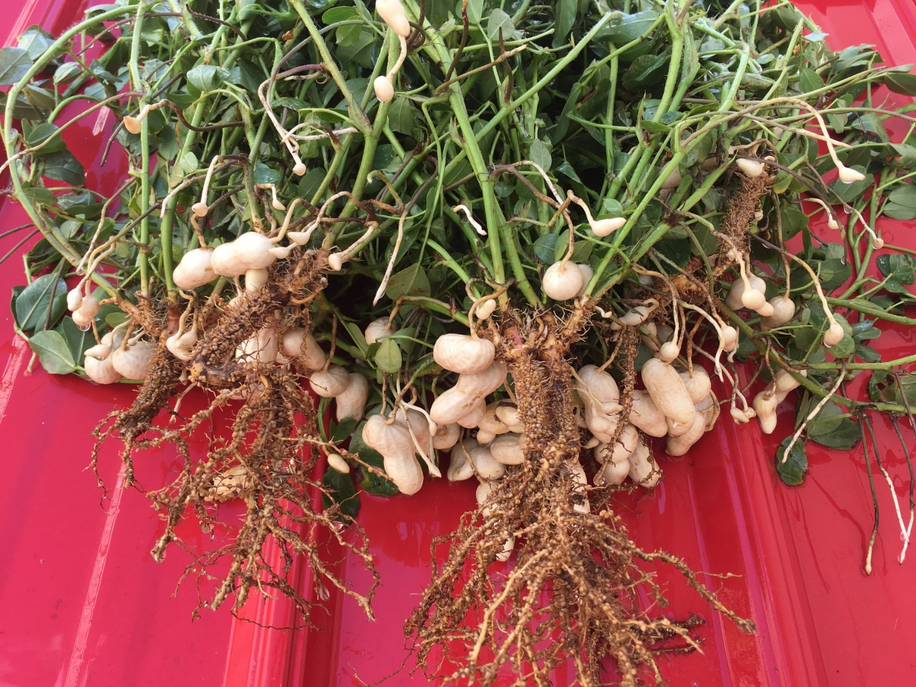
Planted May 4, image taken July 31

Slide 11
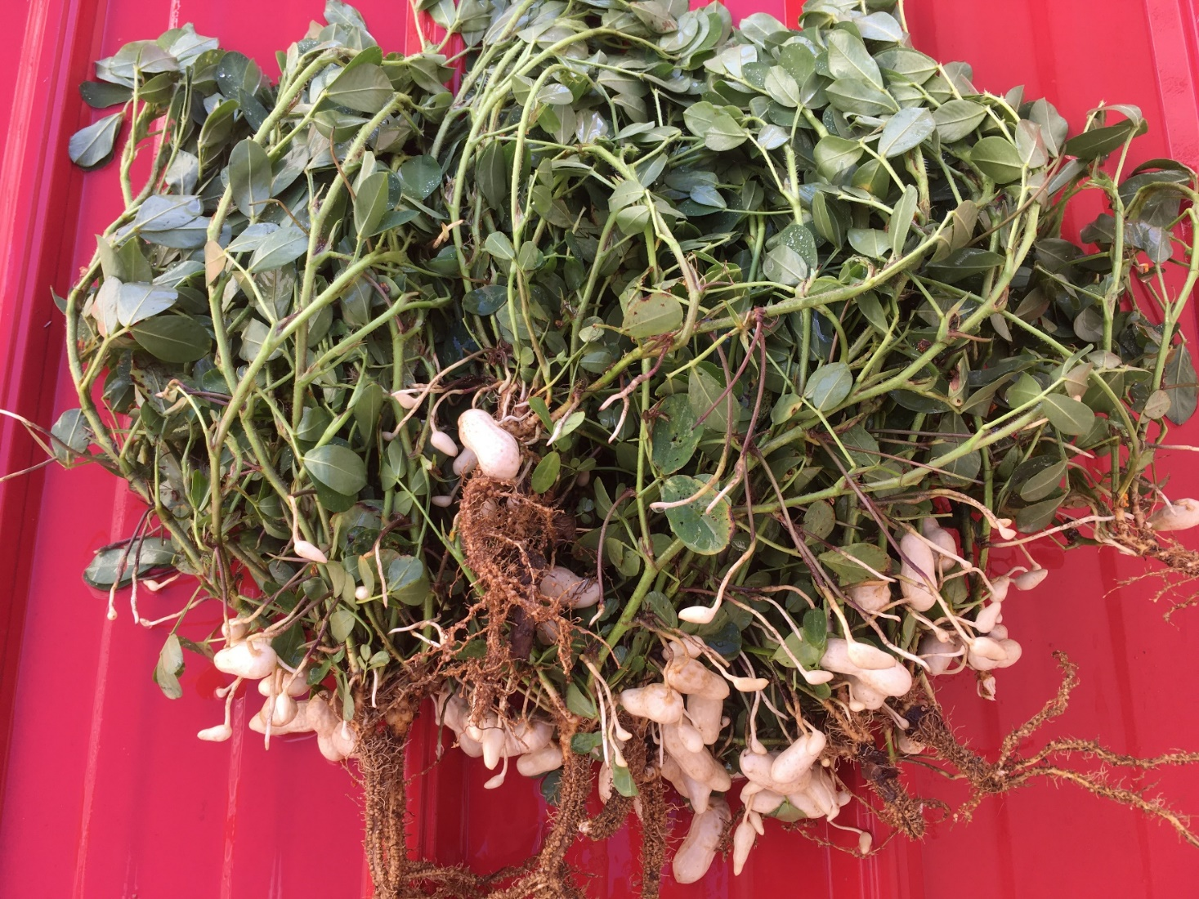
Planted May 14, image taken July 31

Slide 12
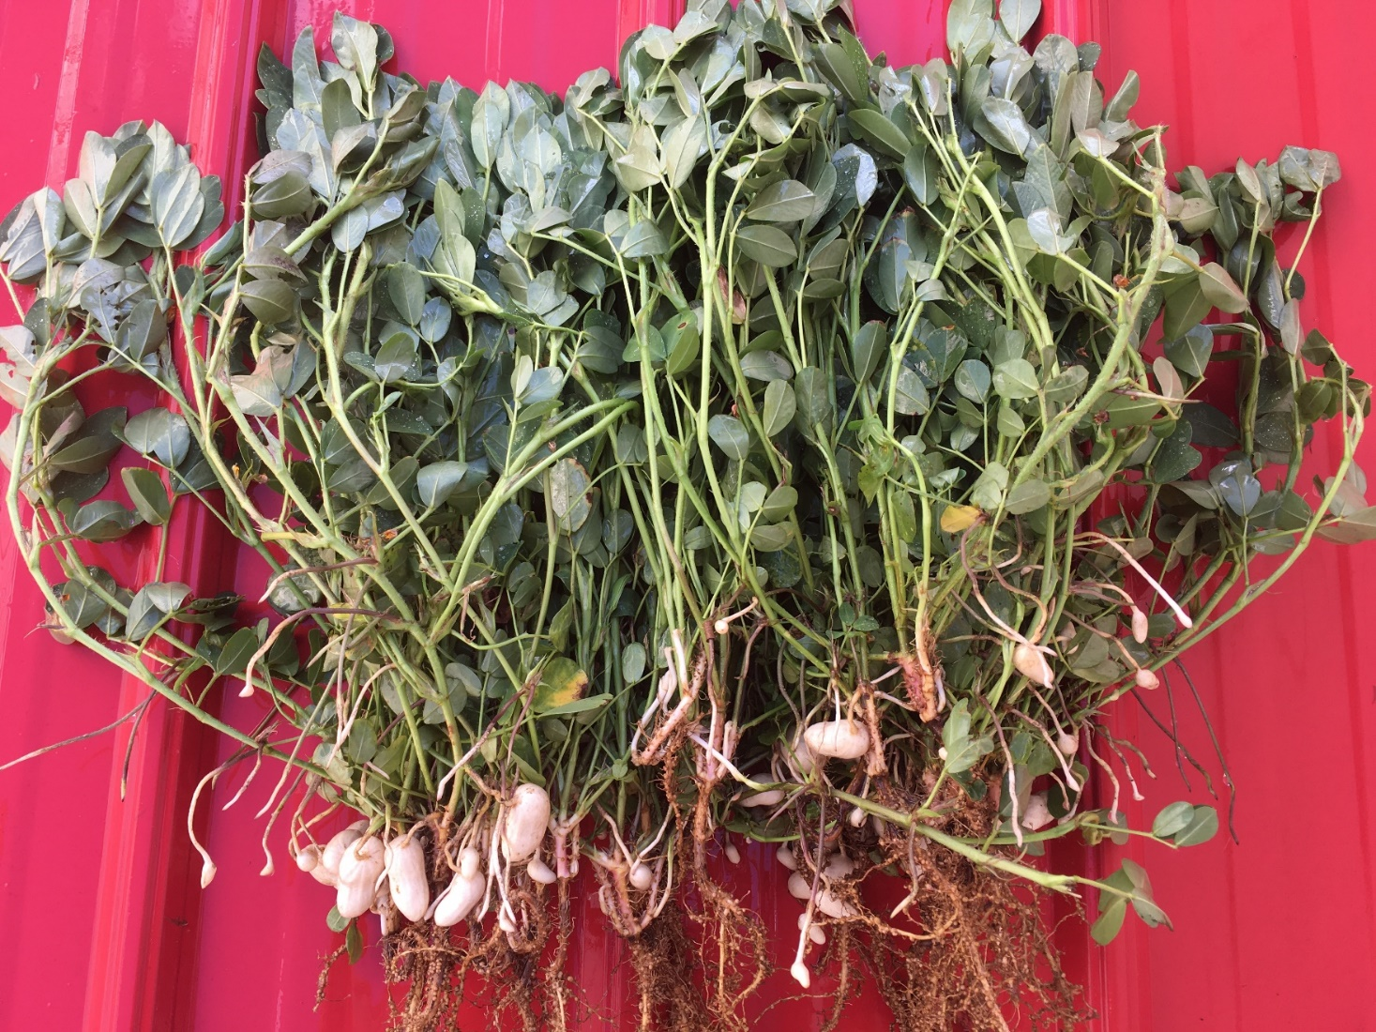
Planted May 29, image taken July 31

Slide 13
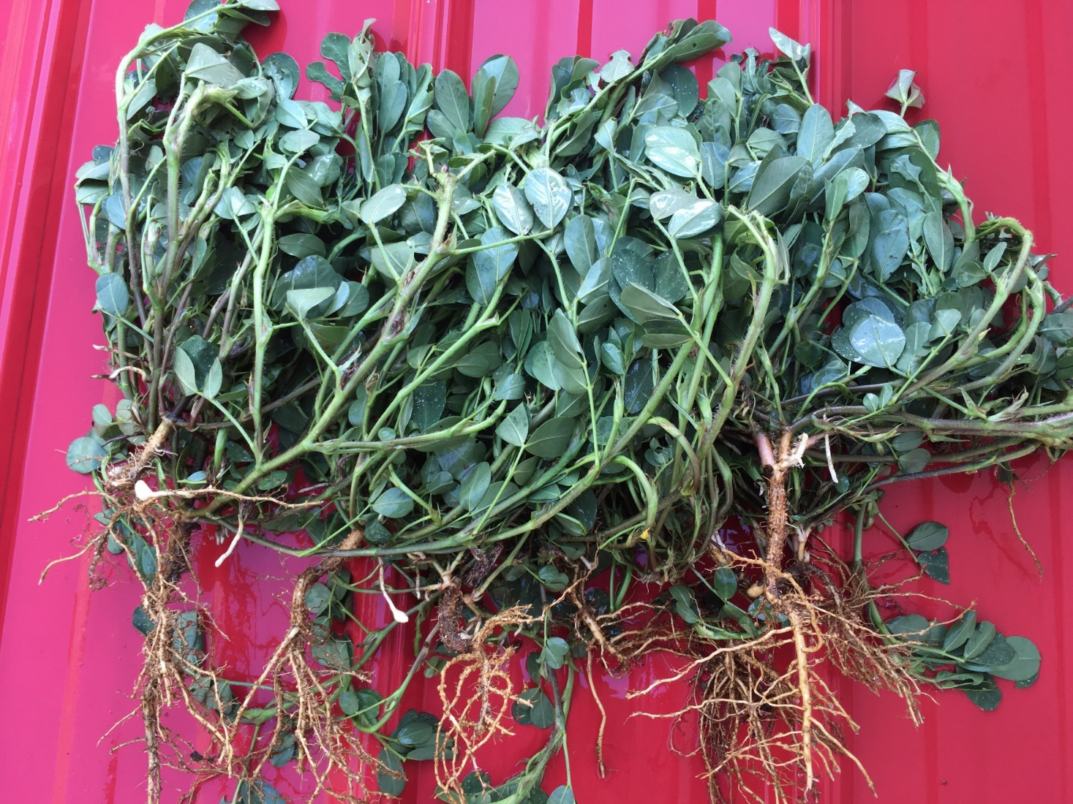
Planted June 9, image taken July 31

Slide 14
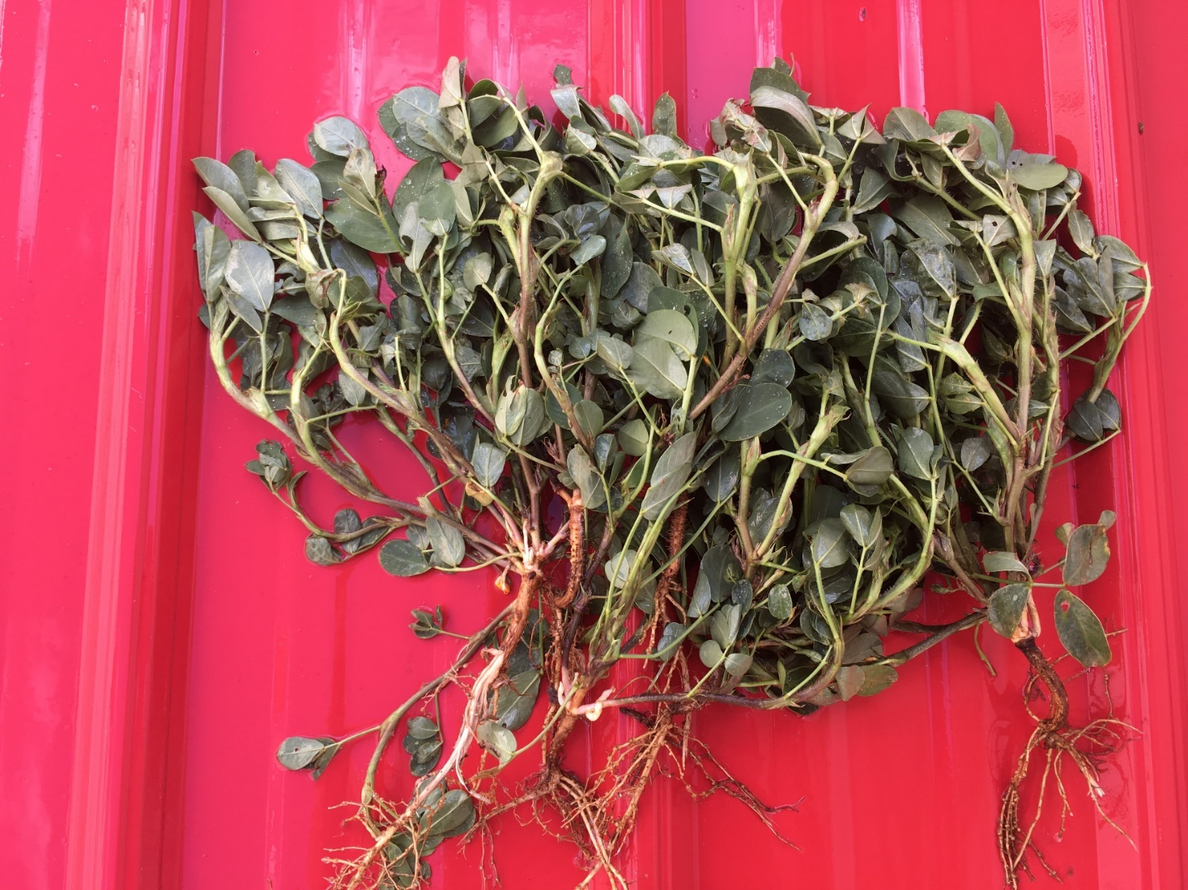
Planted June 25, image taken July 31

Slide 15
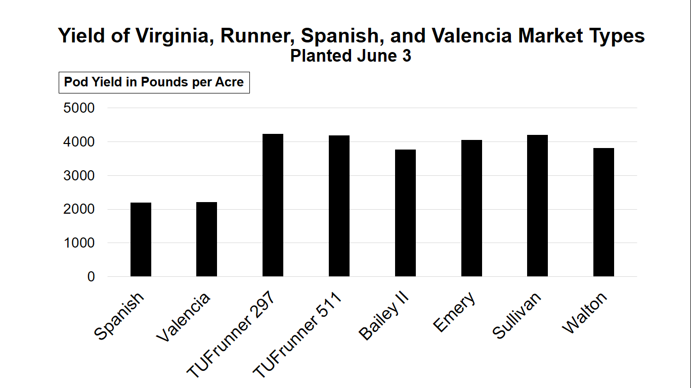

Slide 16
General Production Practices
Apply nutrients based on soil test (pH 5.8 to 6.2)
Avoid excessive Mg and K
Avoid fields with zinc
Establish good rotations (cotton, corn, sorghum)
Plant improved varieties in May
5 seed per foot of row on 36-inch rows
Conventional tillage
Irrigate if possible
Inoculate with Bradyrhizobia for BNF
Apply calcium at pegging
Apply boron and manganese as needed
Dig and harvest in a timely manner
Control pests using IPM practices

Slide 17
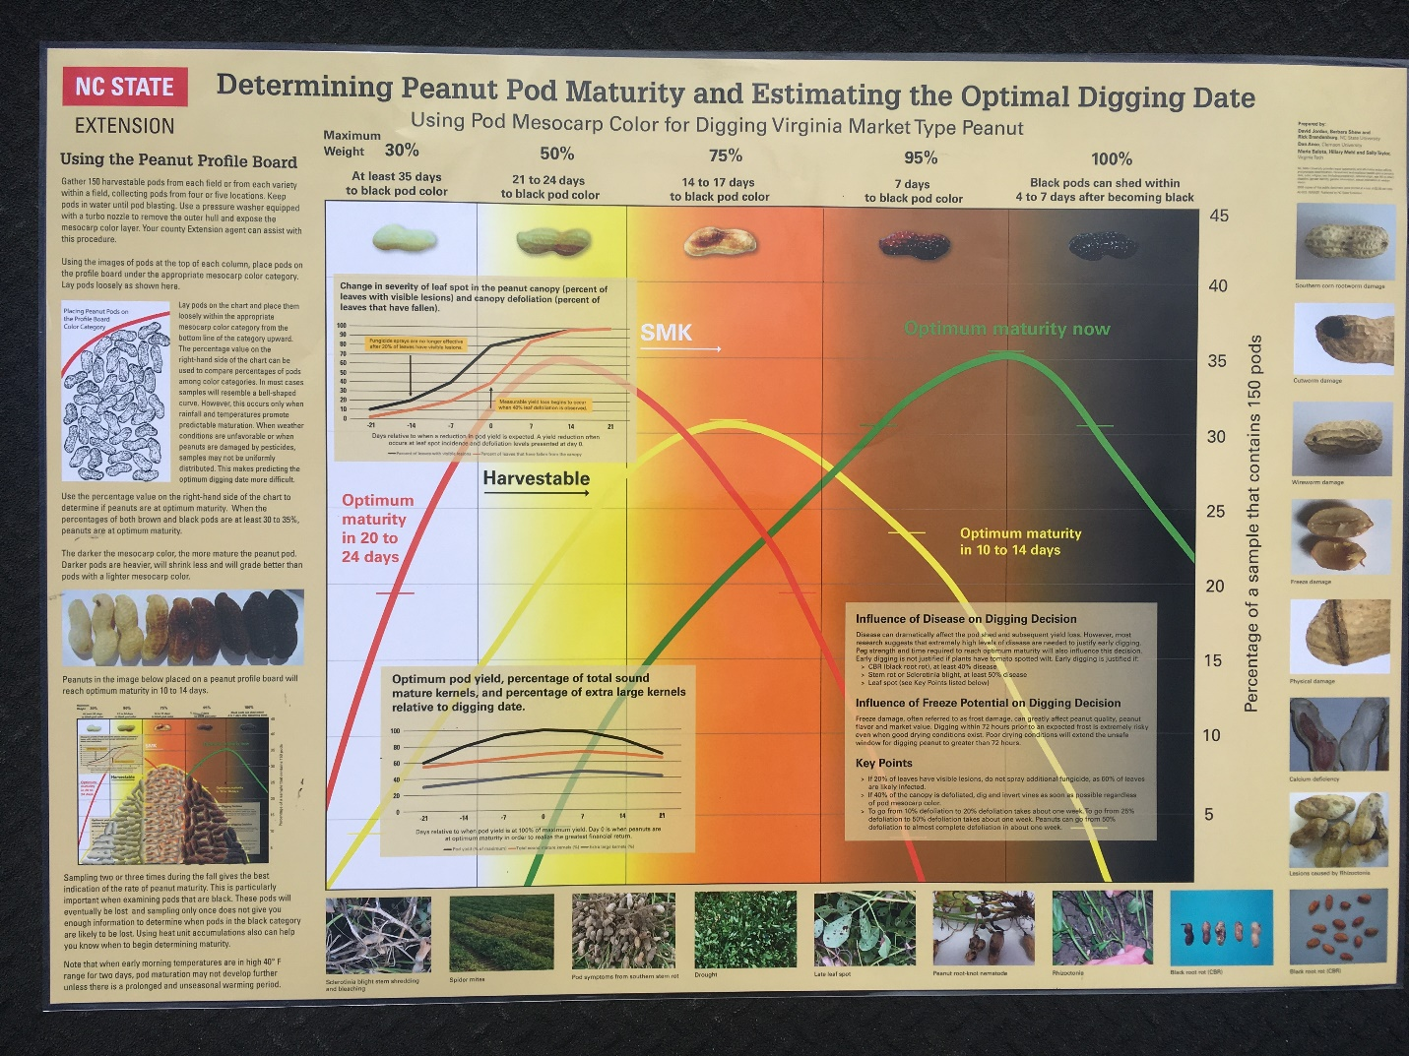

Slide 18
Heat Unit Accumulation
Temperature and moisture influence growth and development
Minor contribution from photoperiod
DD₅₆ (Growing Degree Days) – Base 56, Ceiling, 95
Average temperature for the day – 56 = Heat Units for that day
Sum heat unit accumulation from emergence to a given point
Dry heat
Injury from abiotic and biotic stresses can affect growth and development
Heat units accumulation is a good indicator of when to begin
Pod mesocarp color on a field by field basis is key
2600 DD₅₆ needed for most Virginia market types

Slide 19
Maximum and Minimum Air Temperatures and Heat Unit Accumulation from September 1through October 6 Whiteville

Slide 20
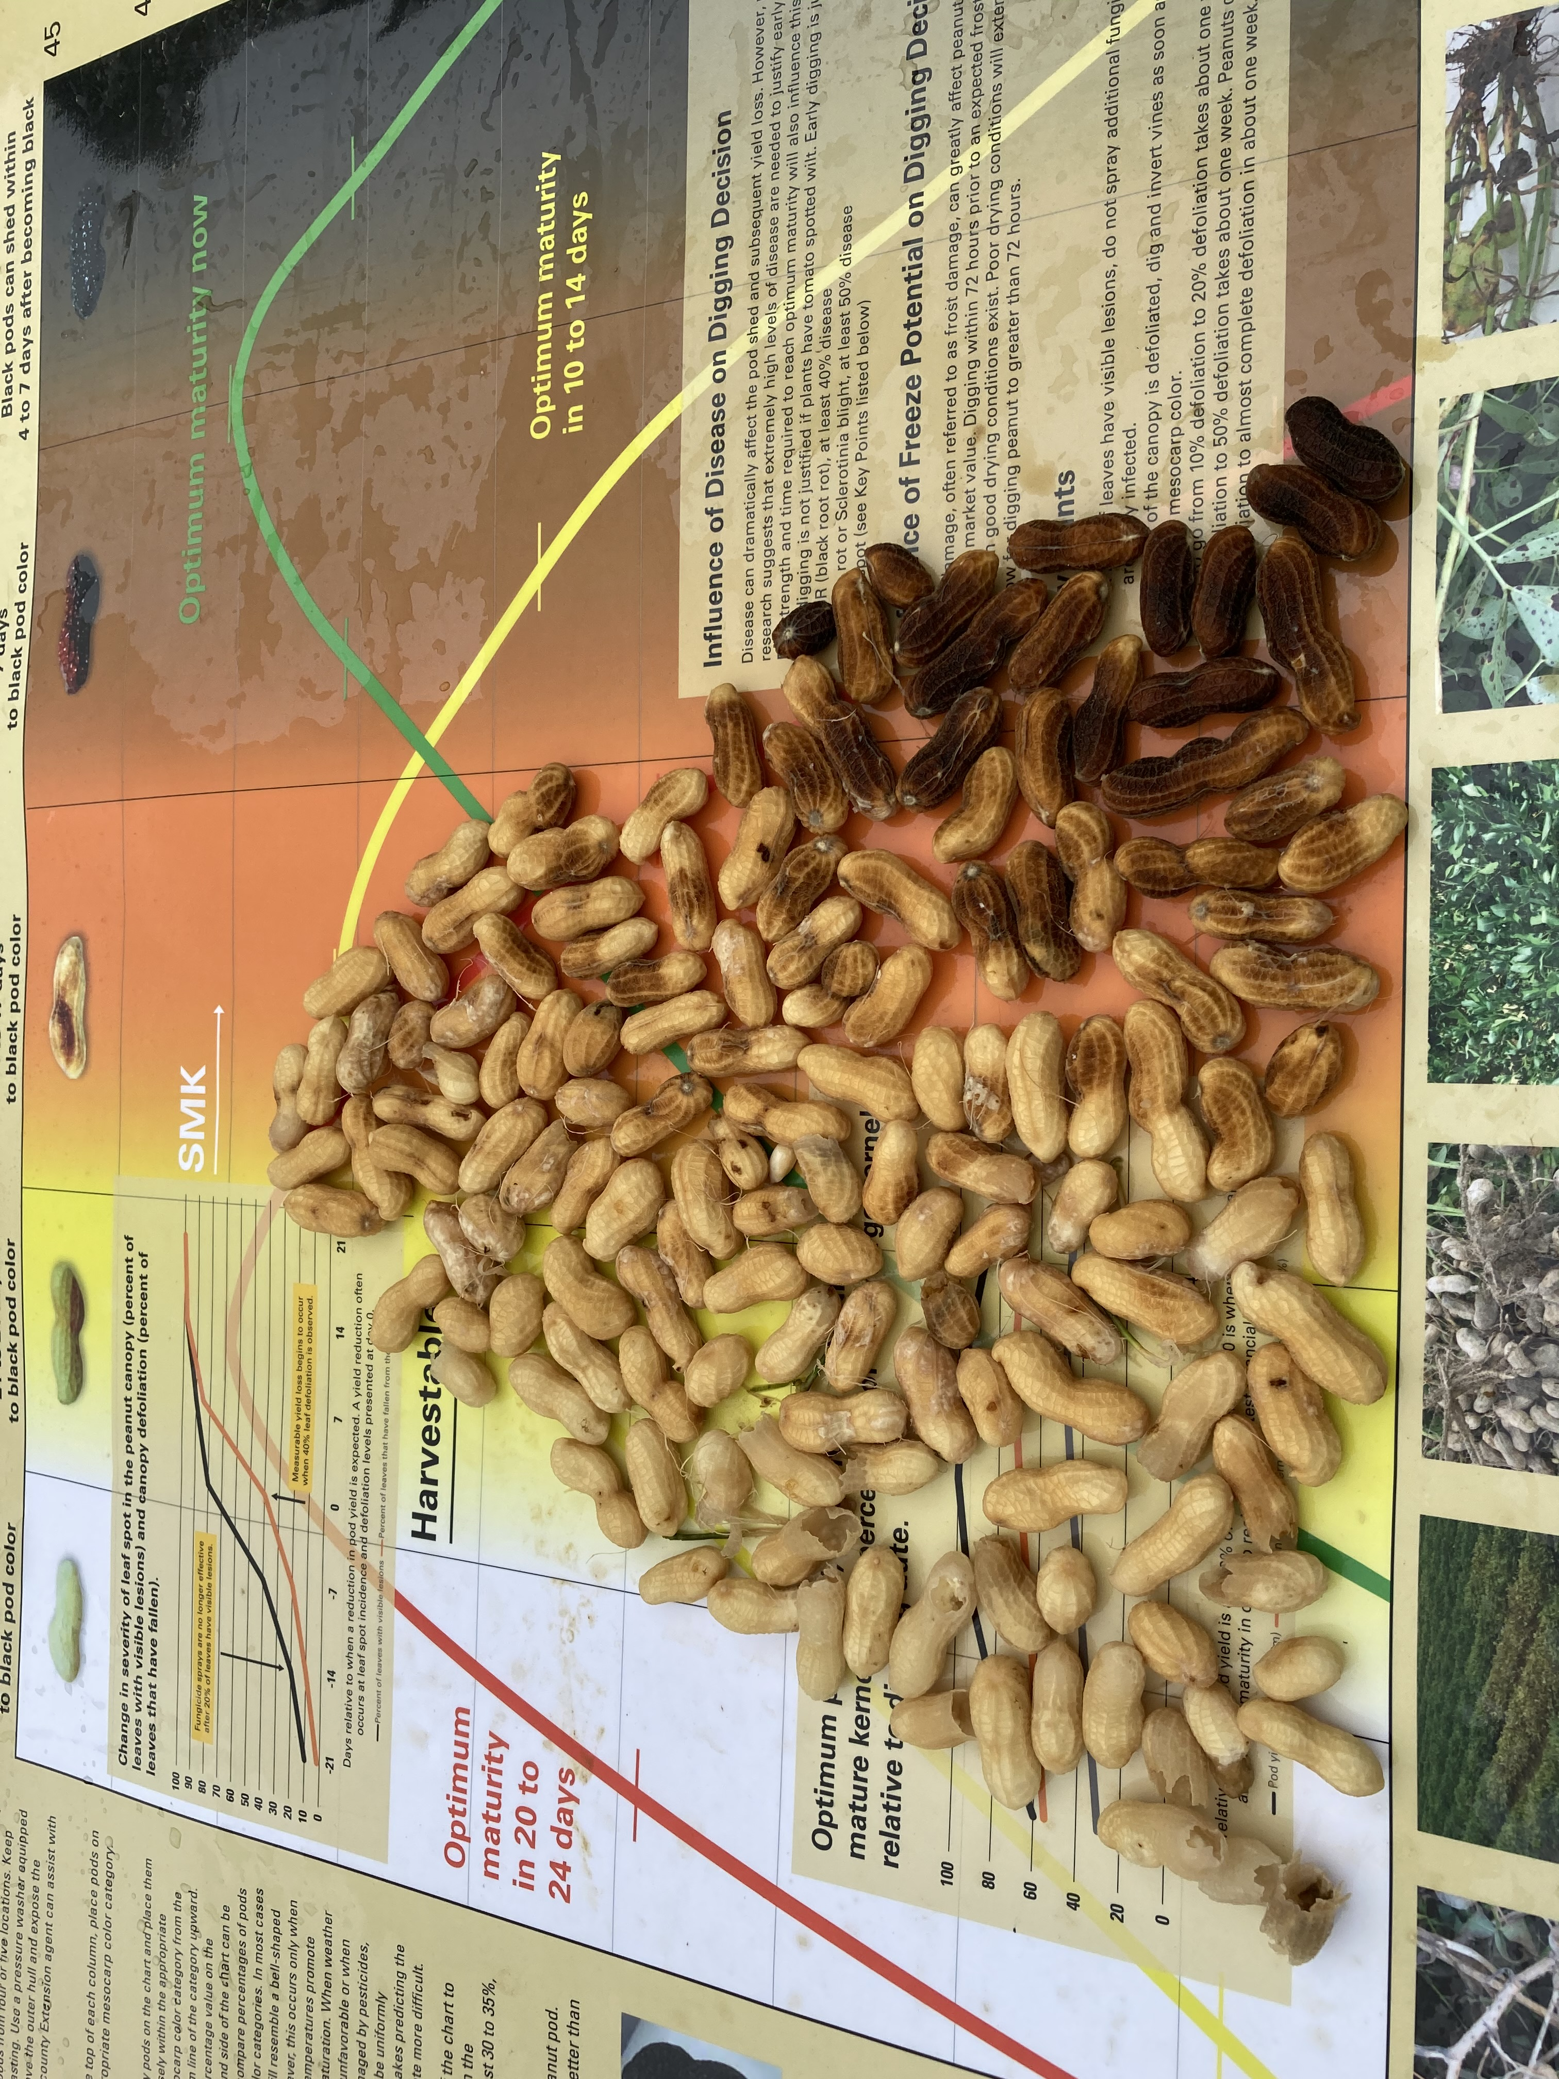
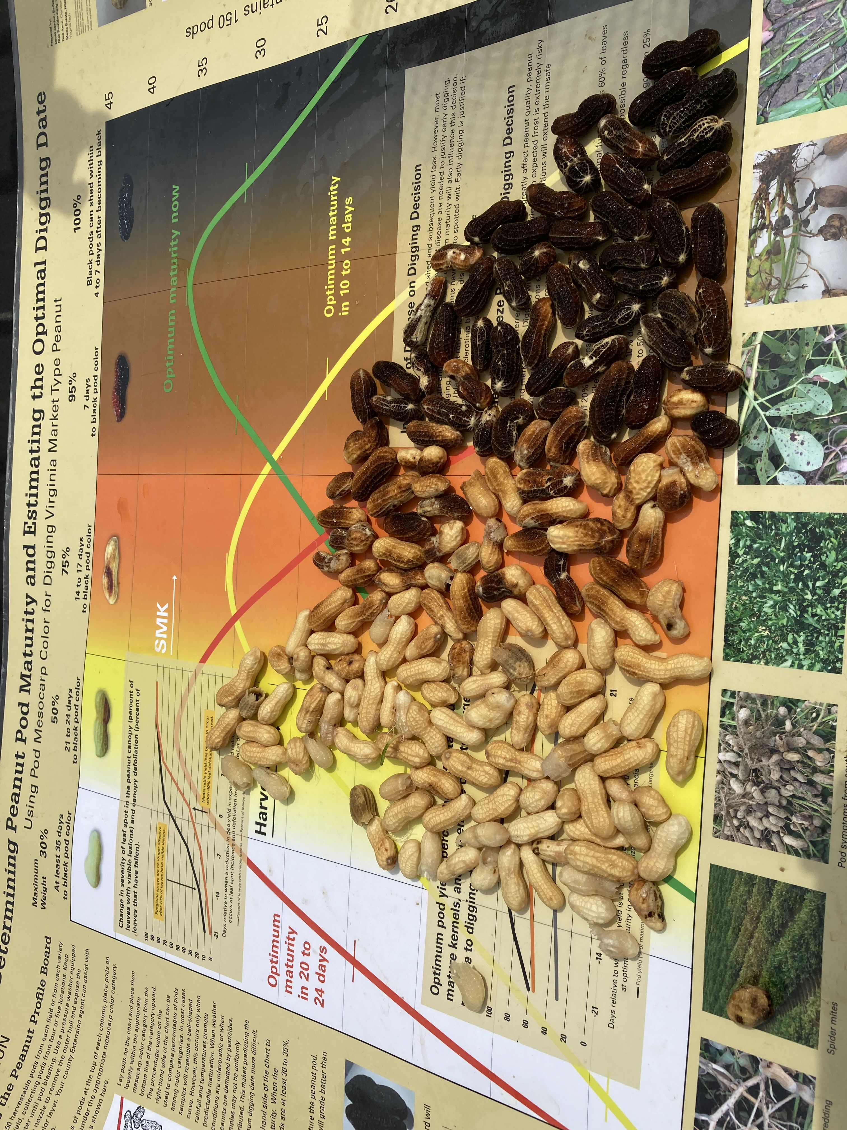
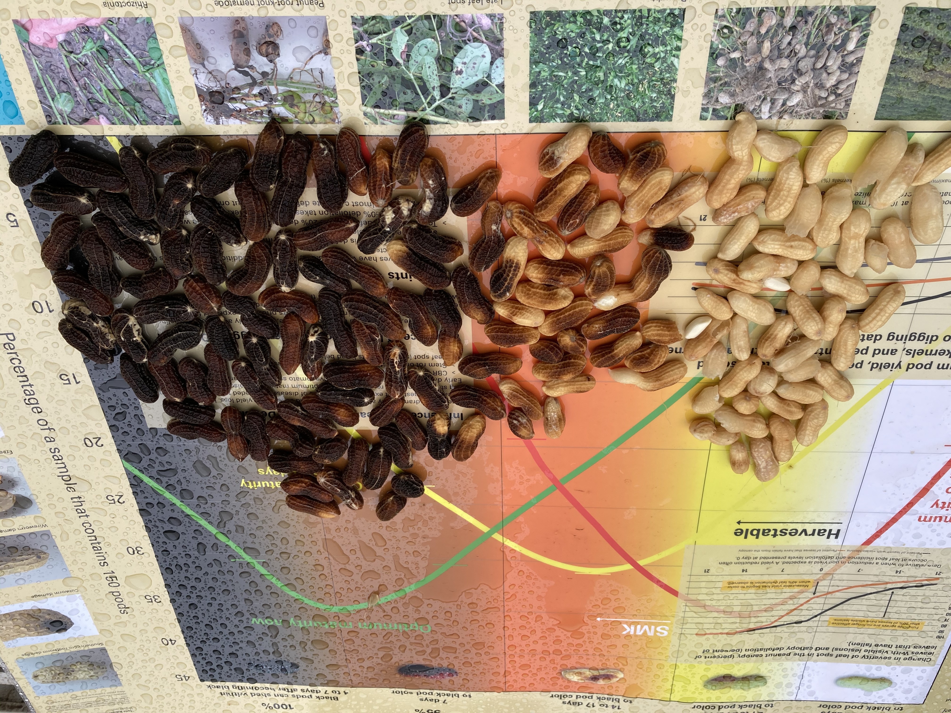
Whiteville, 2020
August 25
September 8
Normal Progression
September 16

Slide 21
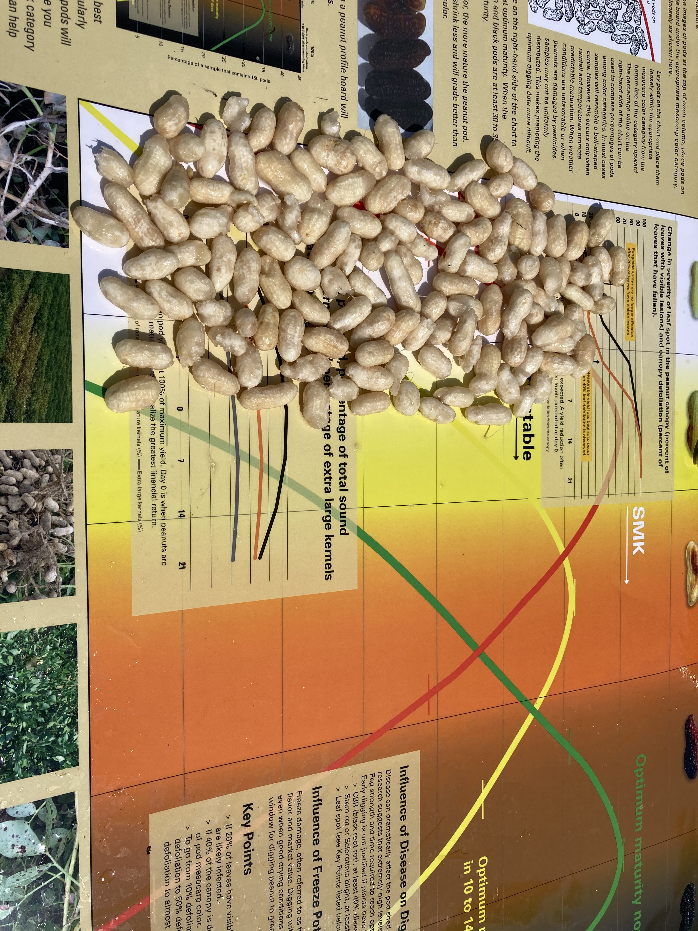
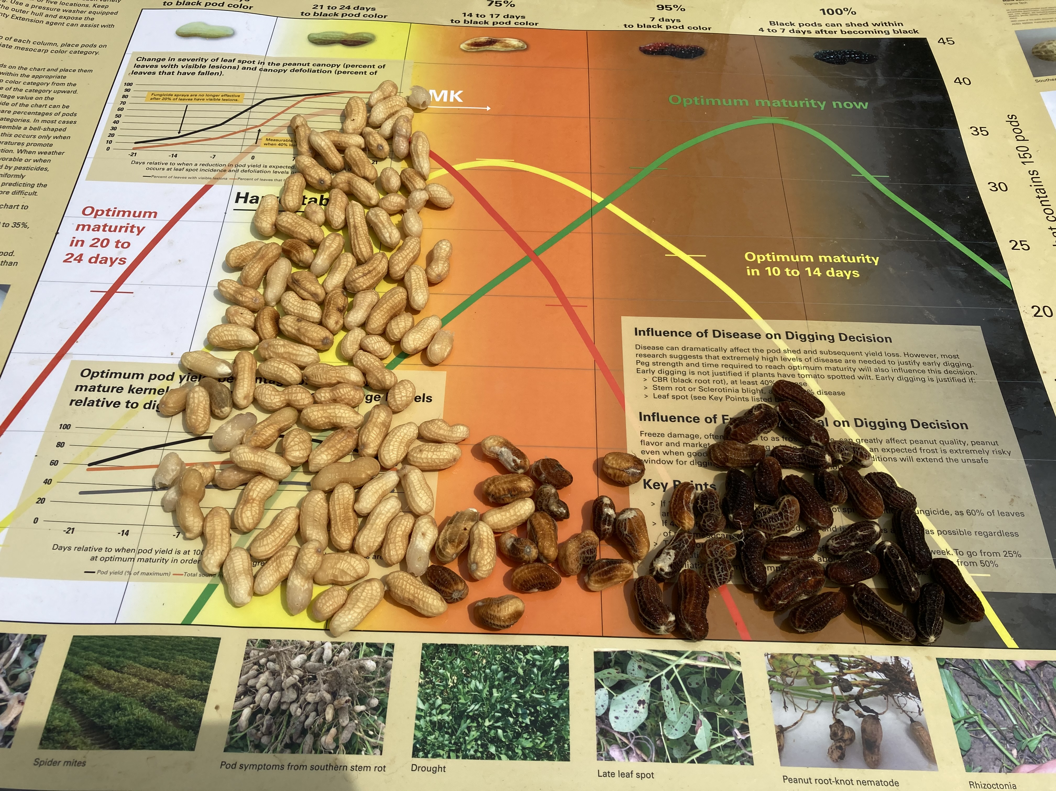
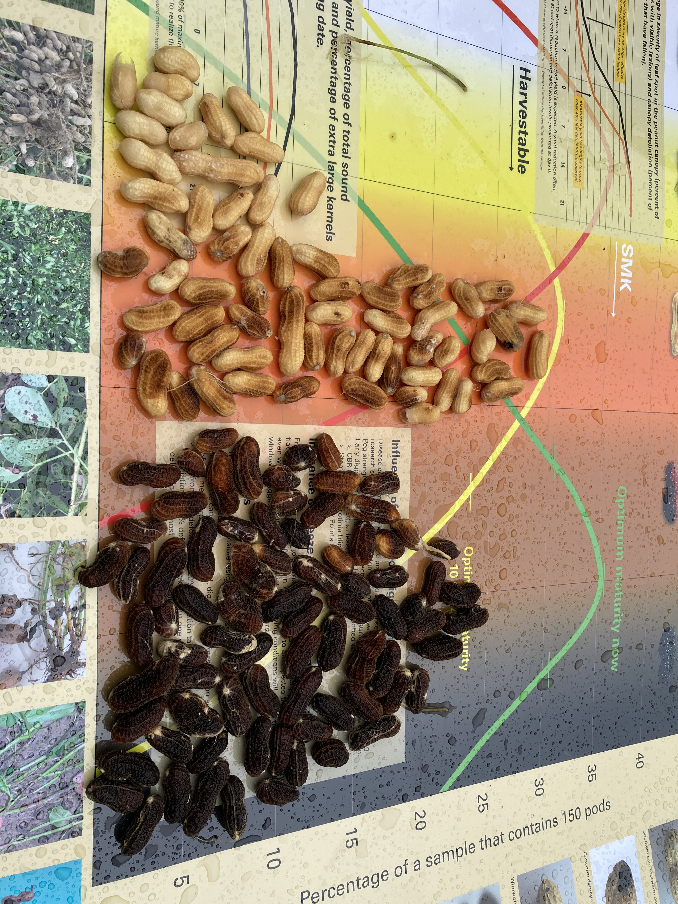
Whiteville, 2020
August 25
September 8
Split Crop?
September 16

Slide 22
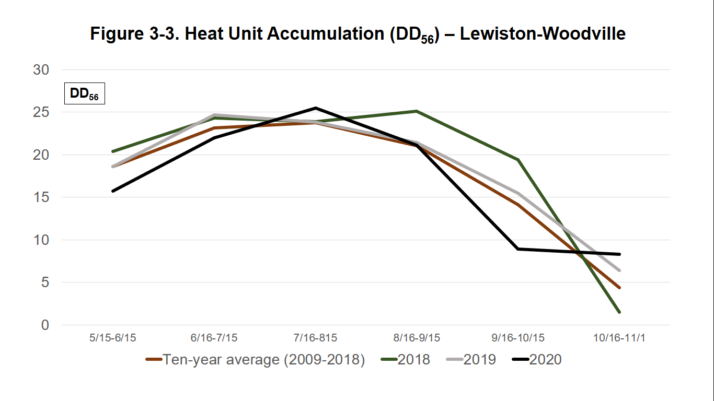
Heat Unit Accumulation
Lewiston-Woodville

Slide 23
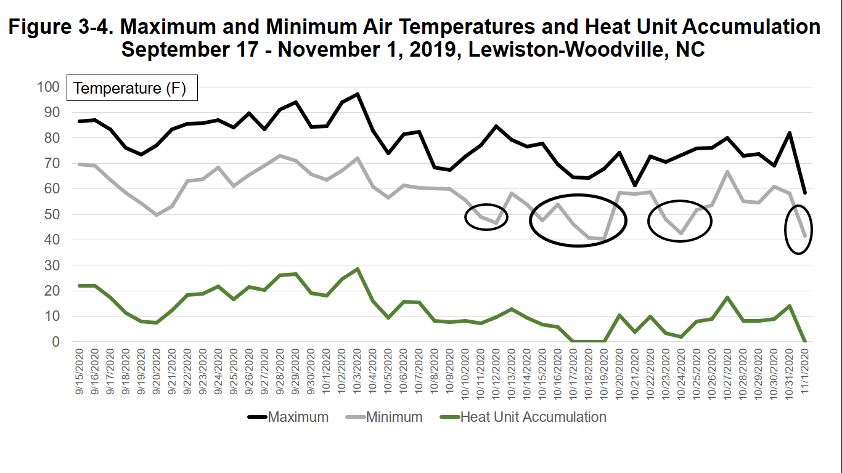
Lewiston-Woodville, 2019

Slide 24
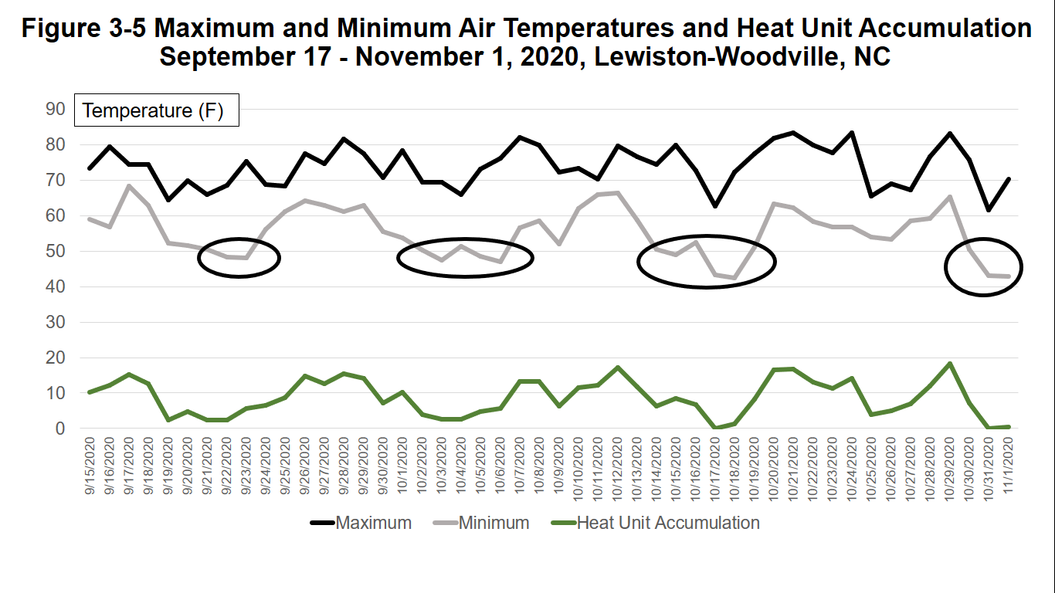
Lewiston-Woodville, 2020

Slide 25
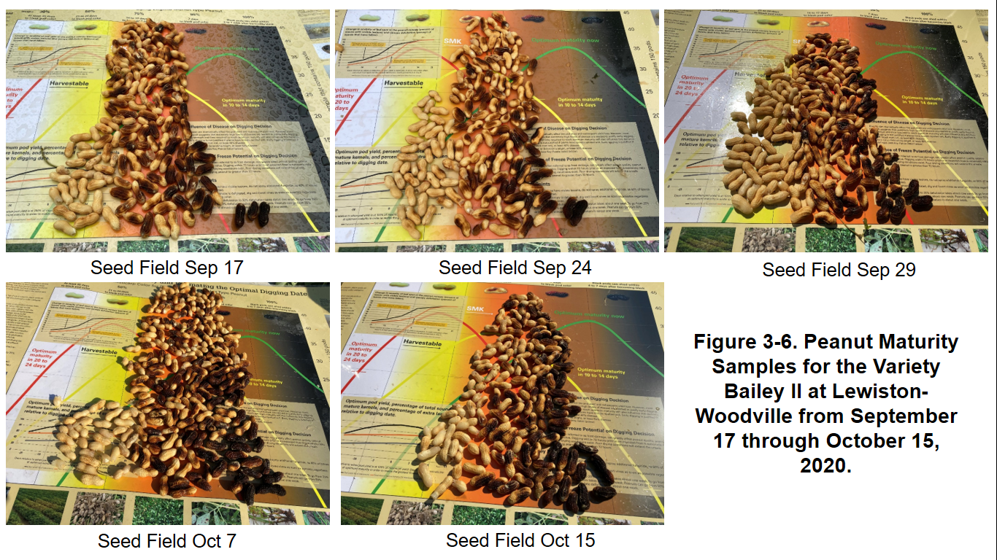

Slide 26
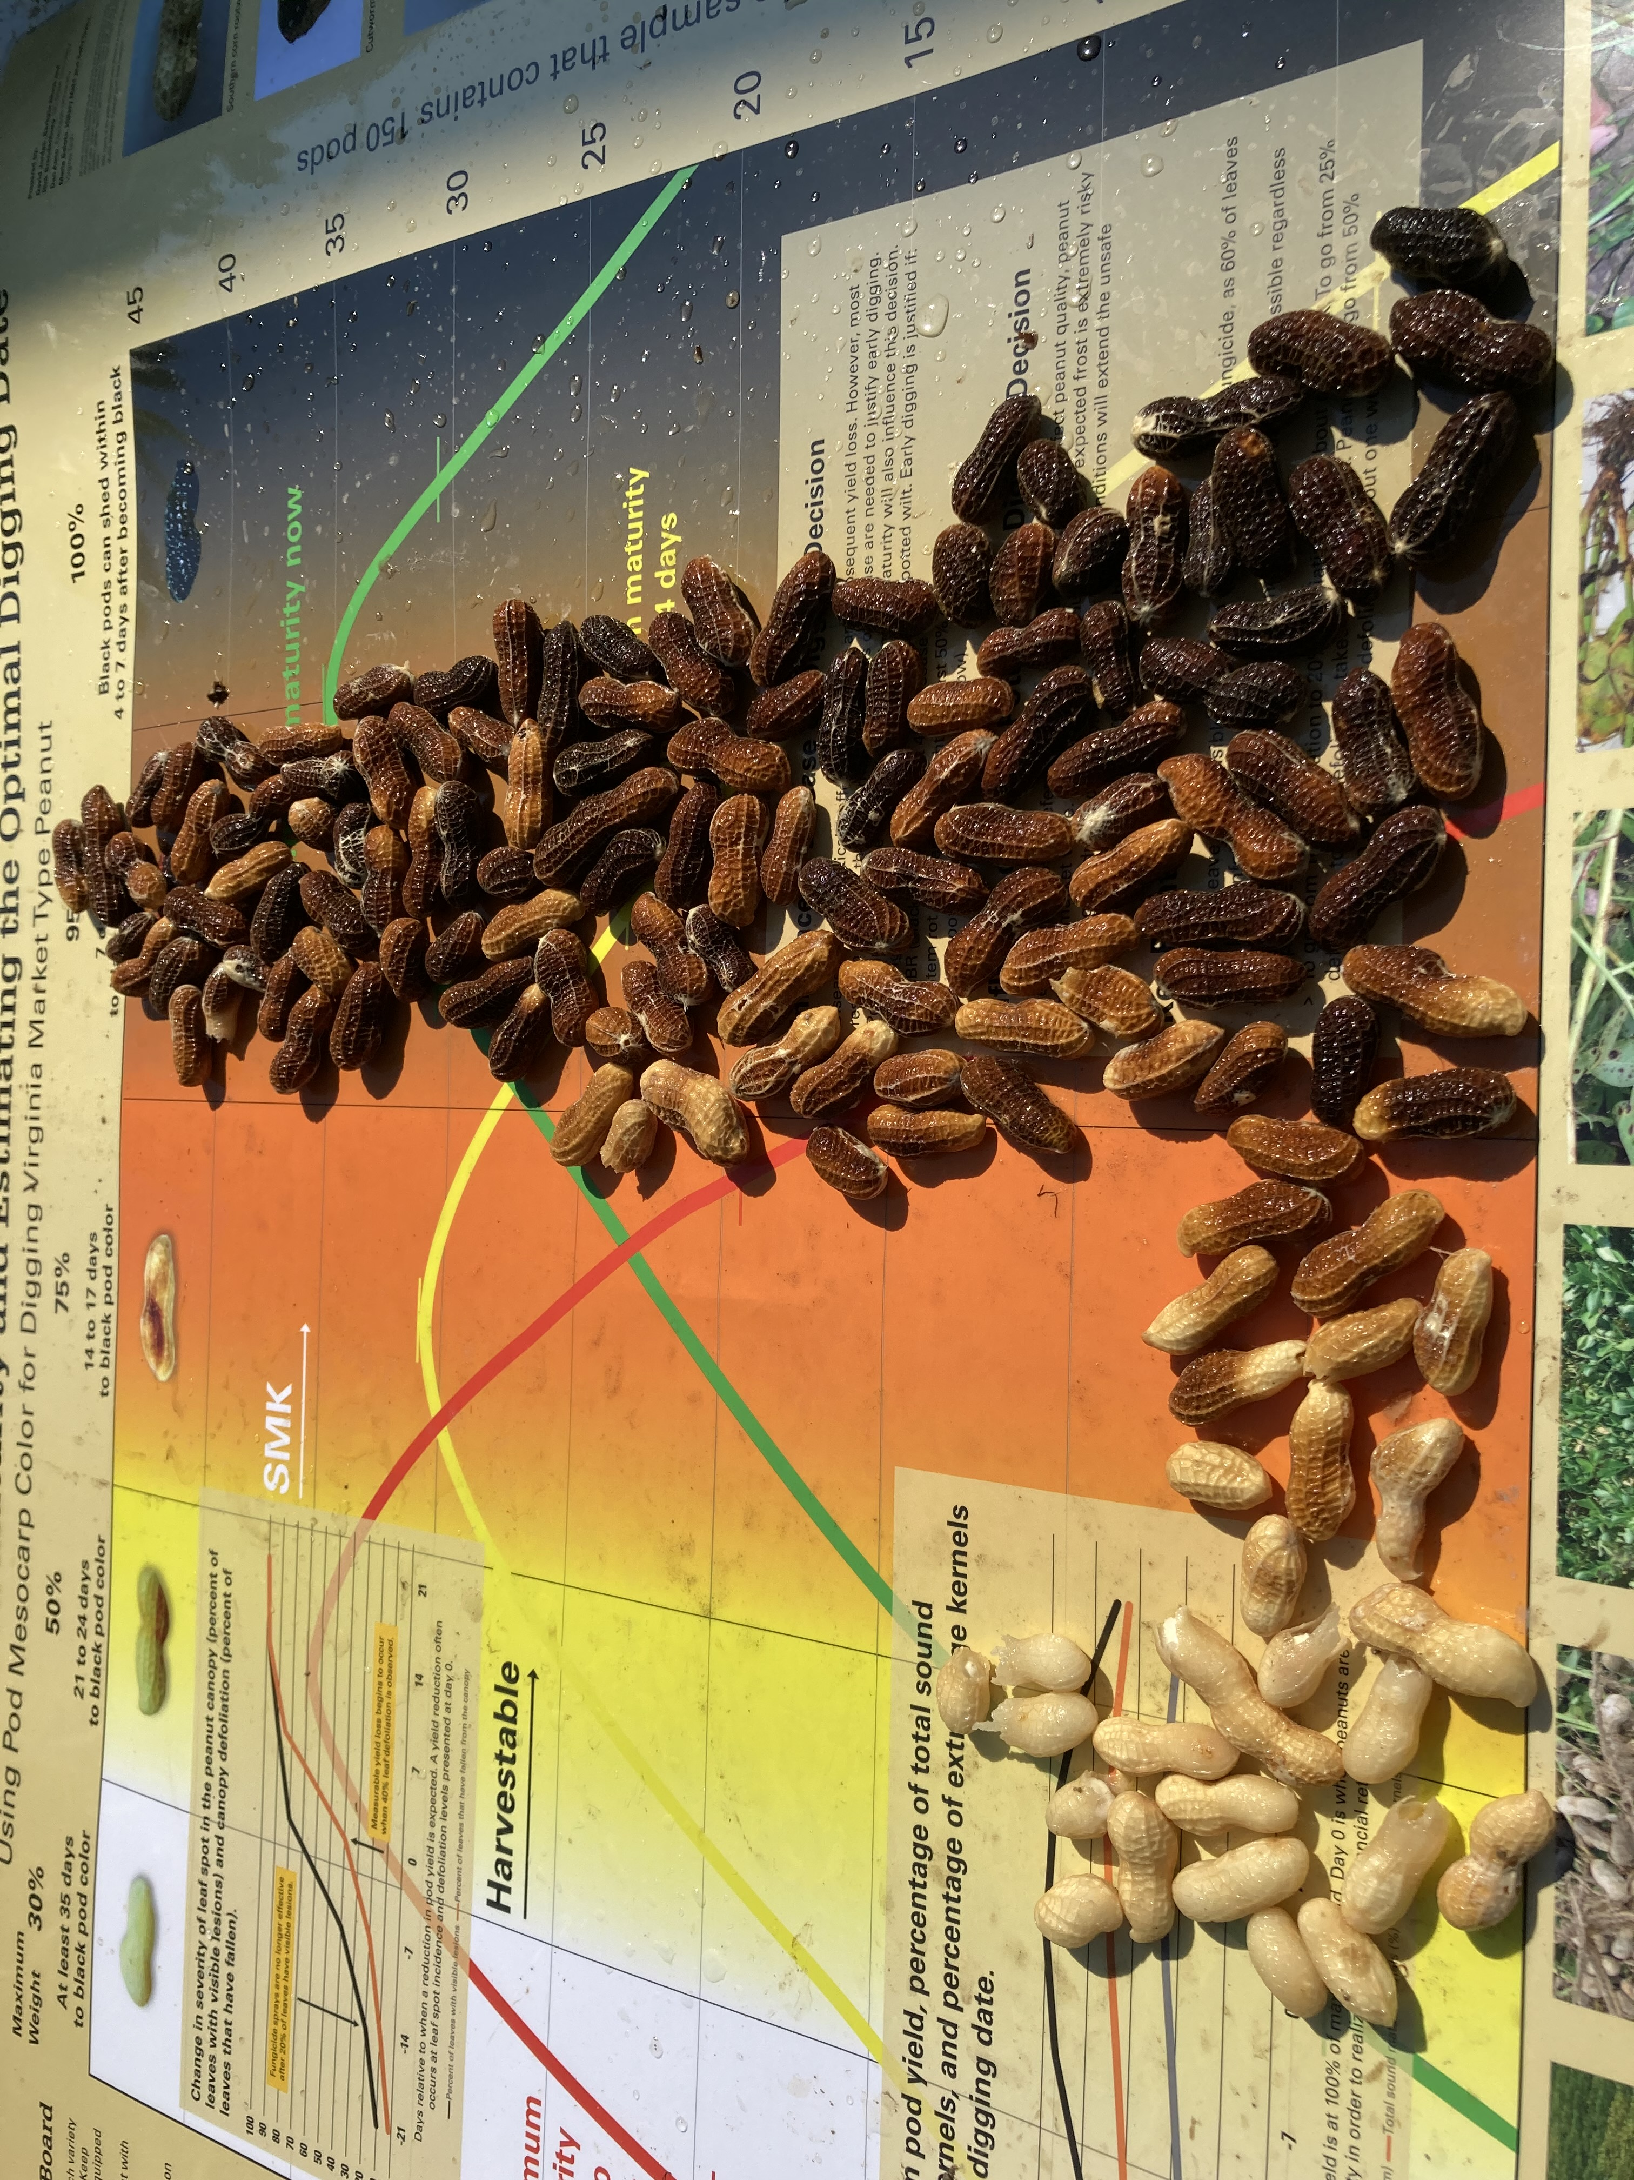

Slide 27
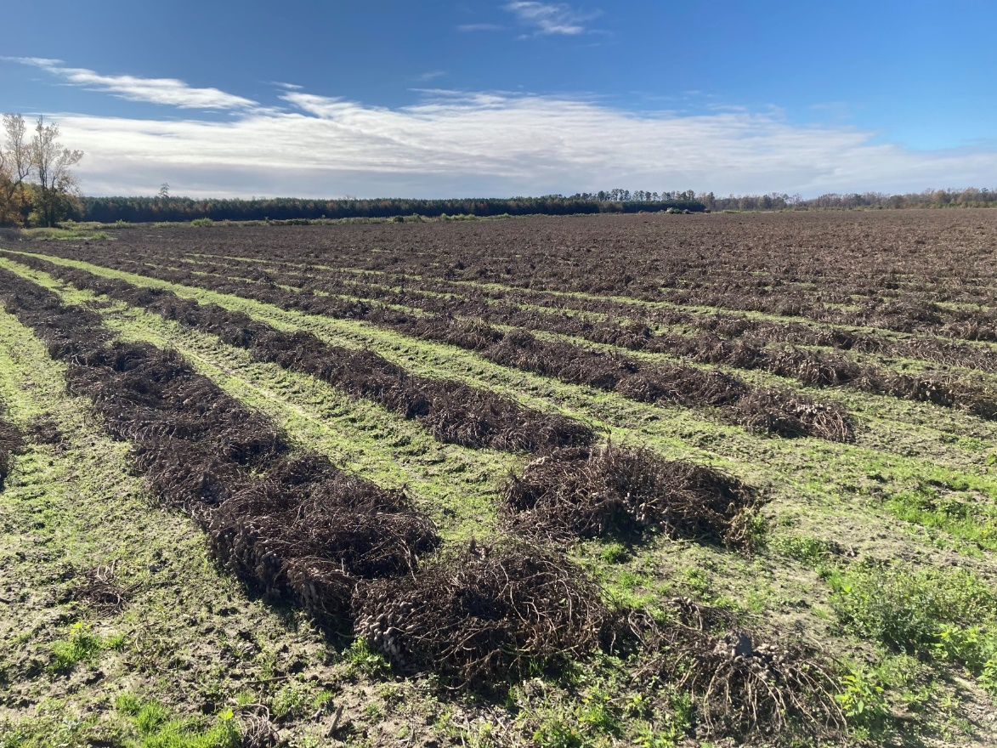
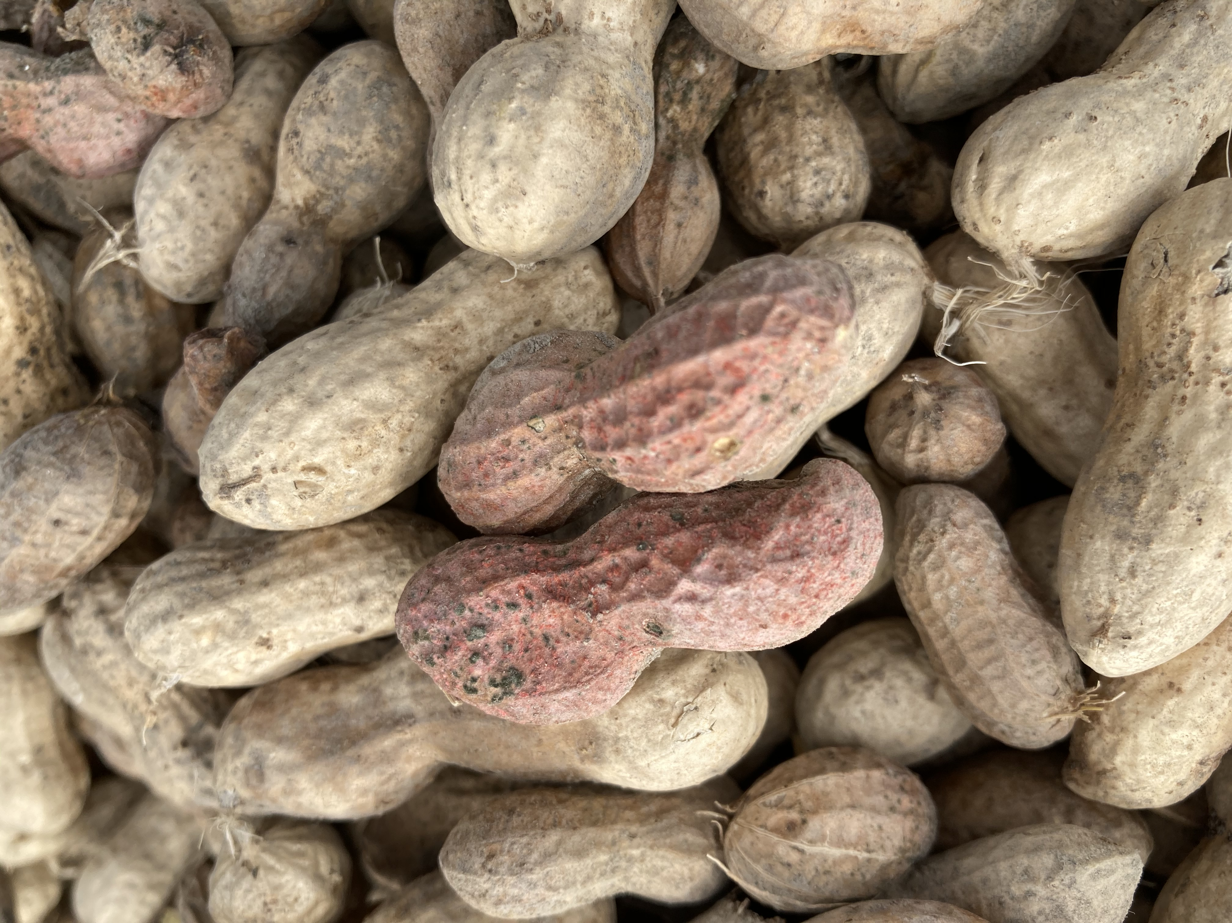
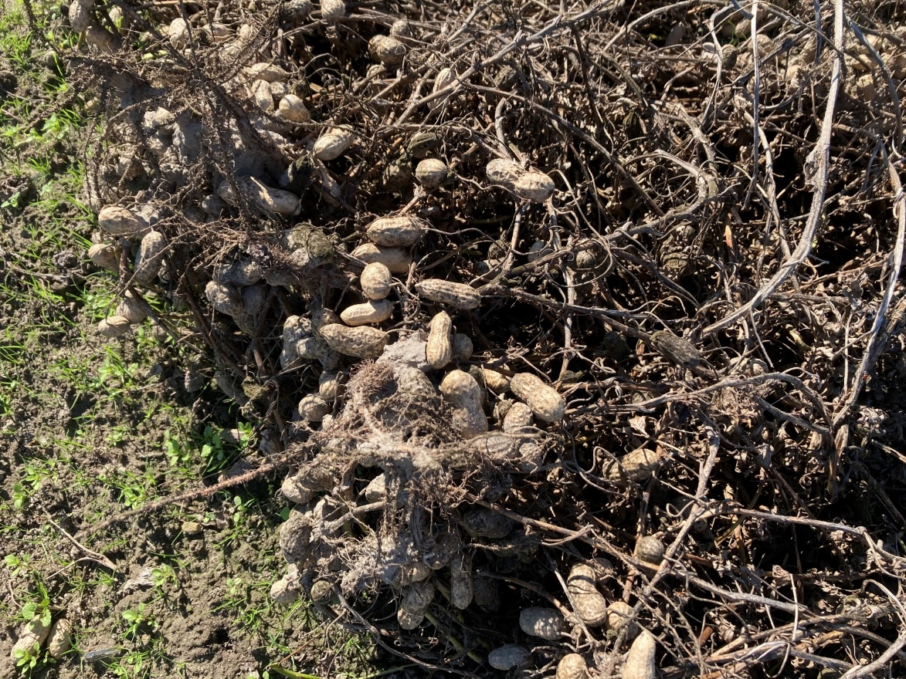
Fusarium

Slide 28
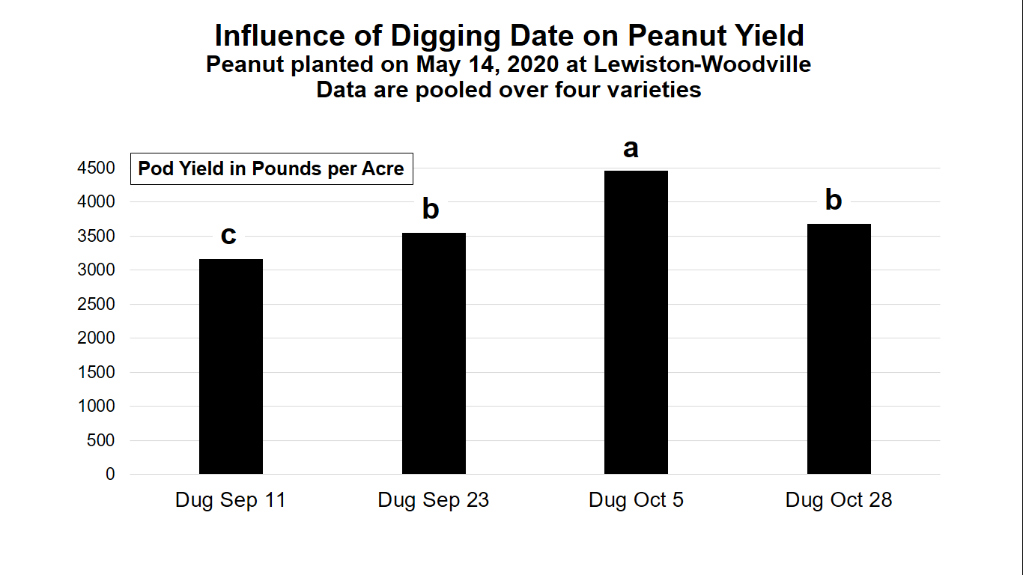

Slide 29
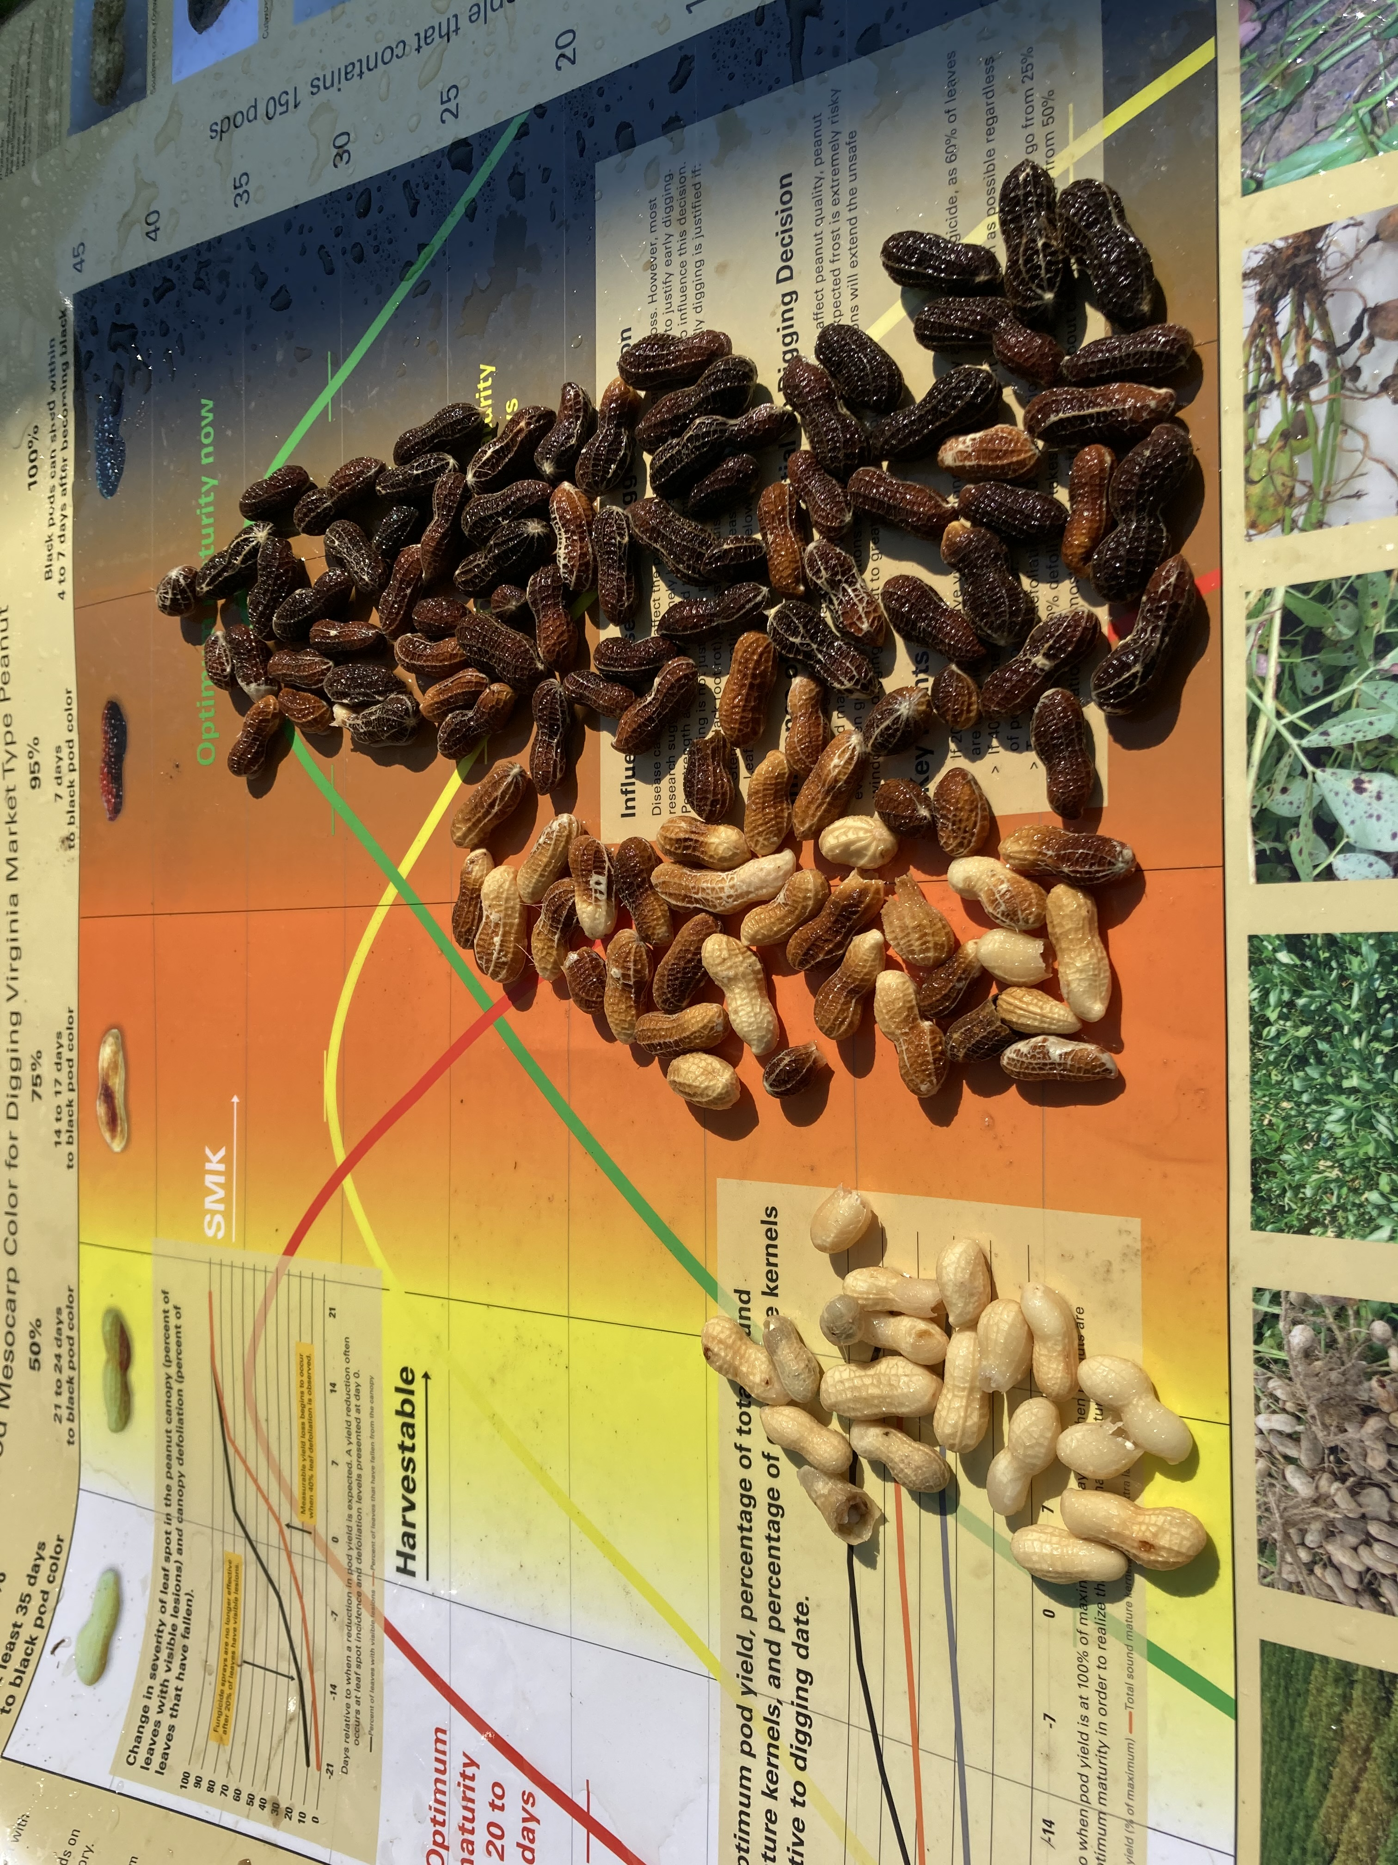
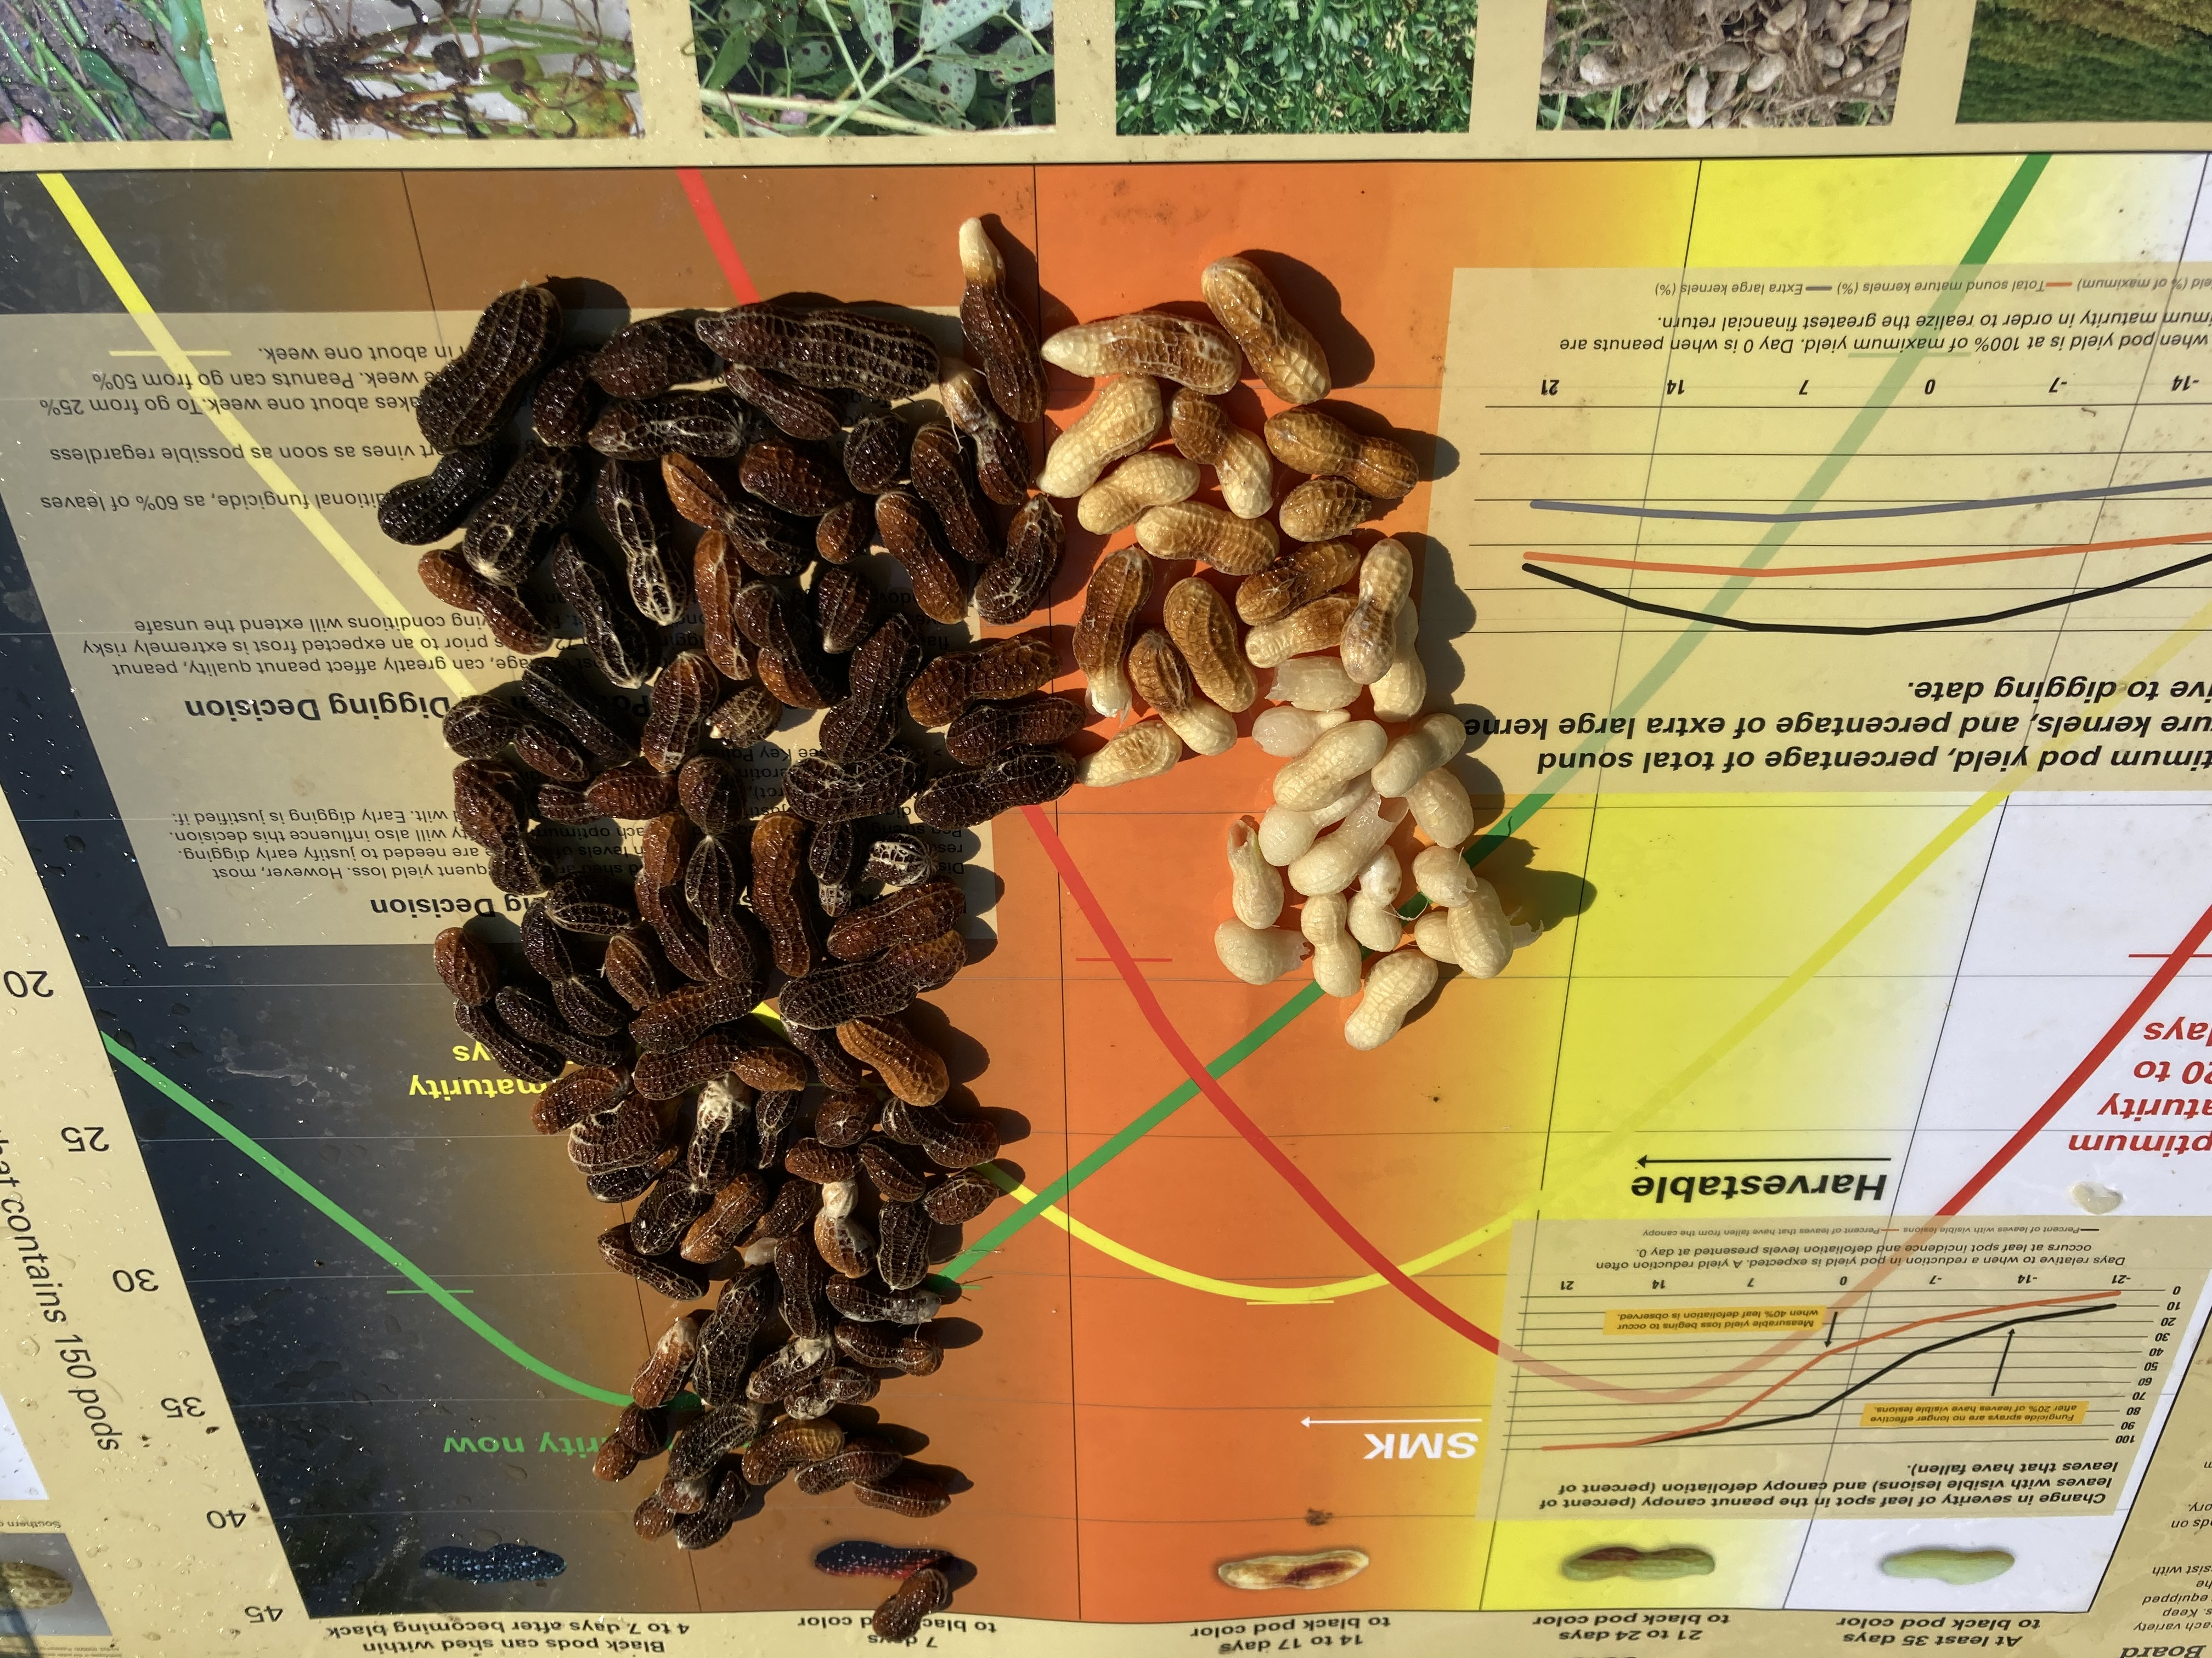
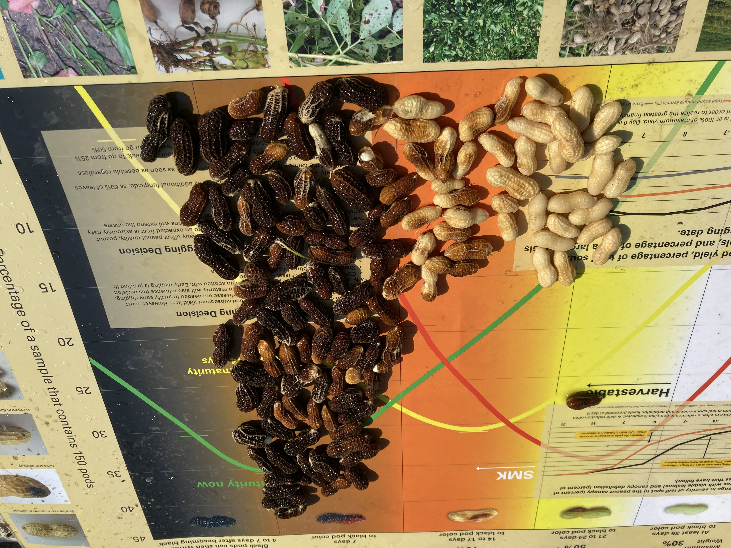
Lewiston-Woodville
Planted May 14
Image October 13
Bailey II
Emery
Sullivan

Slide 31
Digging Pods and Inverting Vines
Assume 10 hours per day at 3.0 mph
30 acres per day with 4-row digger
40 acres per day with 6-row digger
250 acres with one 6-row digger – 7, 10-hour days
500 acres with one 6-row digger – 14, 10-hour days
750 acres with one 6-row digger – 21, 10-hour days

Slide 32
Harvesting
Eight-row self-propelled (SP) – 25 acres per day
Six-row self-propelled – 20 acres per day
Six-row pull type – 20 acres per day
Four-row pull type – 15 acres per day
250 acres with one 6-row SP – 13, 10-hour days
500 acres with one 6-row SP – 25, 10-hour days
750 acres with one 6-row SP – 38, 10-hour days
Drying and Hauling Capacity?
Buying Point Challenges (trailer turn around)?

Slide 33
General Production Practices
Apply nutrients based on soil test (pH 5.8 to 6.2)
Avoid excessive Mg and K
Avoid fields with zinc
Establish good rotations (cotton, corn, sorghum)
Plant improved varieties in May
5 seed per foot of row on 36-inch rows
Conventional tillage
Irrigate if possible
Inoculate with Bradyrhizobia for BNF
Apply calcium at pegging
Apply boron and manganese as needed
Dig and harvest in a timely manner
Control pests using IPM practices

Slide 34
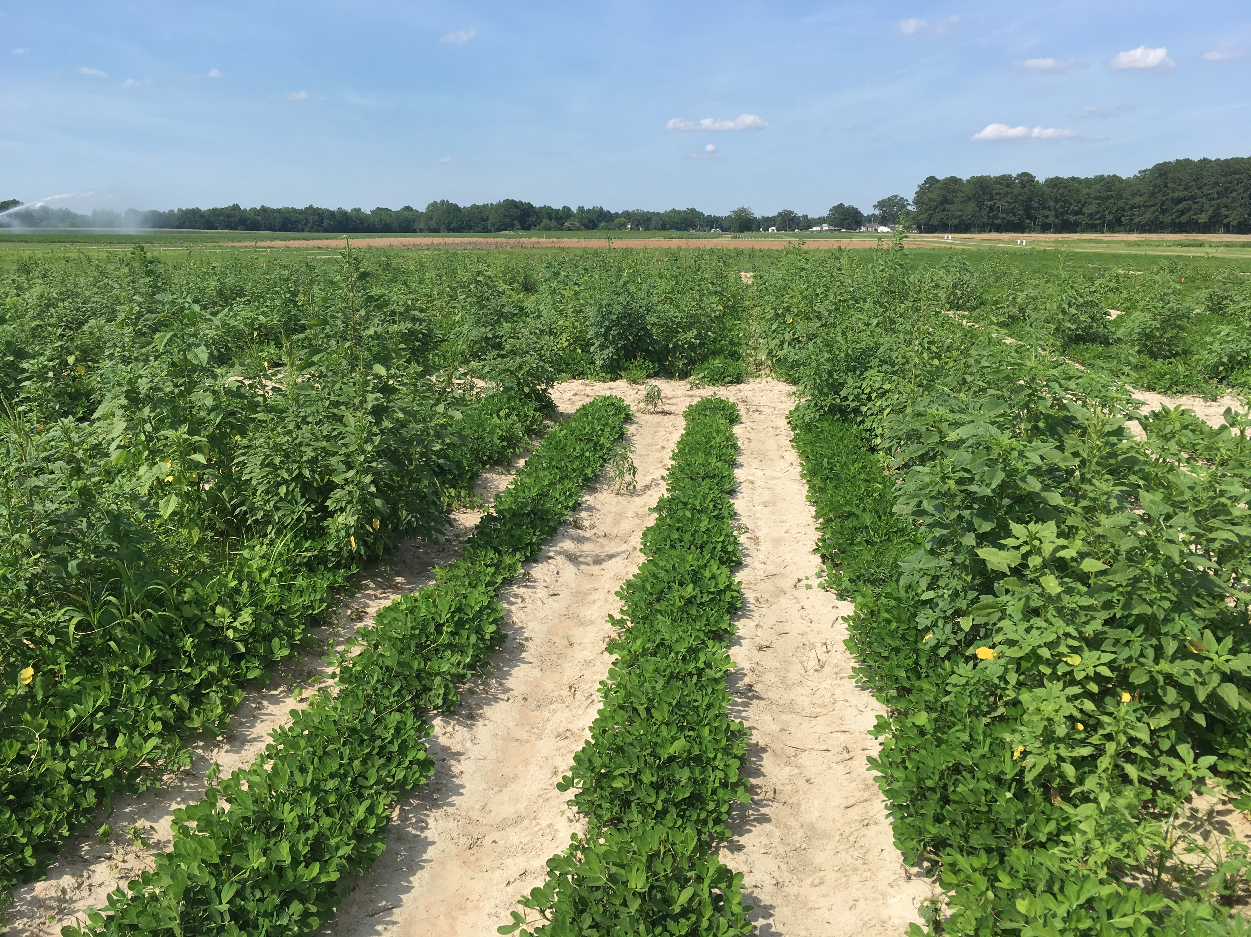

Slide 35
Seed production when Palmer amaranth emerged with the crop
Seeds (Number/plant)

Slide 36
Seed production when Palmer amaranth emerged 3 weeks after the crop
Seeds (Number/plant)
Note Scale

Slide 37
Postemergence Options
Paraquat applied within 28 days after emergence
Basagran, Ultra Blazer, Storm, Cobra
Cadre and Pursuit
Various formulations of 2,4-DB
Clethodim (various formulations), Poast, and Poast Plus
Dual, Dual Magnum, Warrant, Outlook, Zidua, Anthem Flex
Paraquat (wiper/roller application)

Slide 38
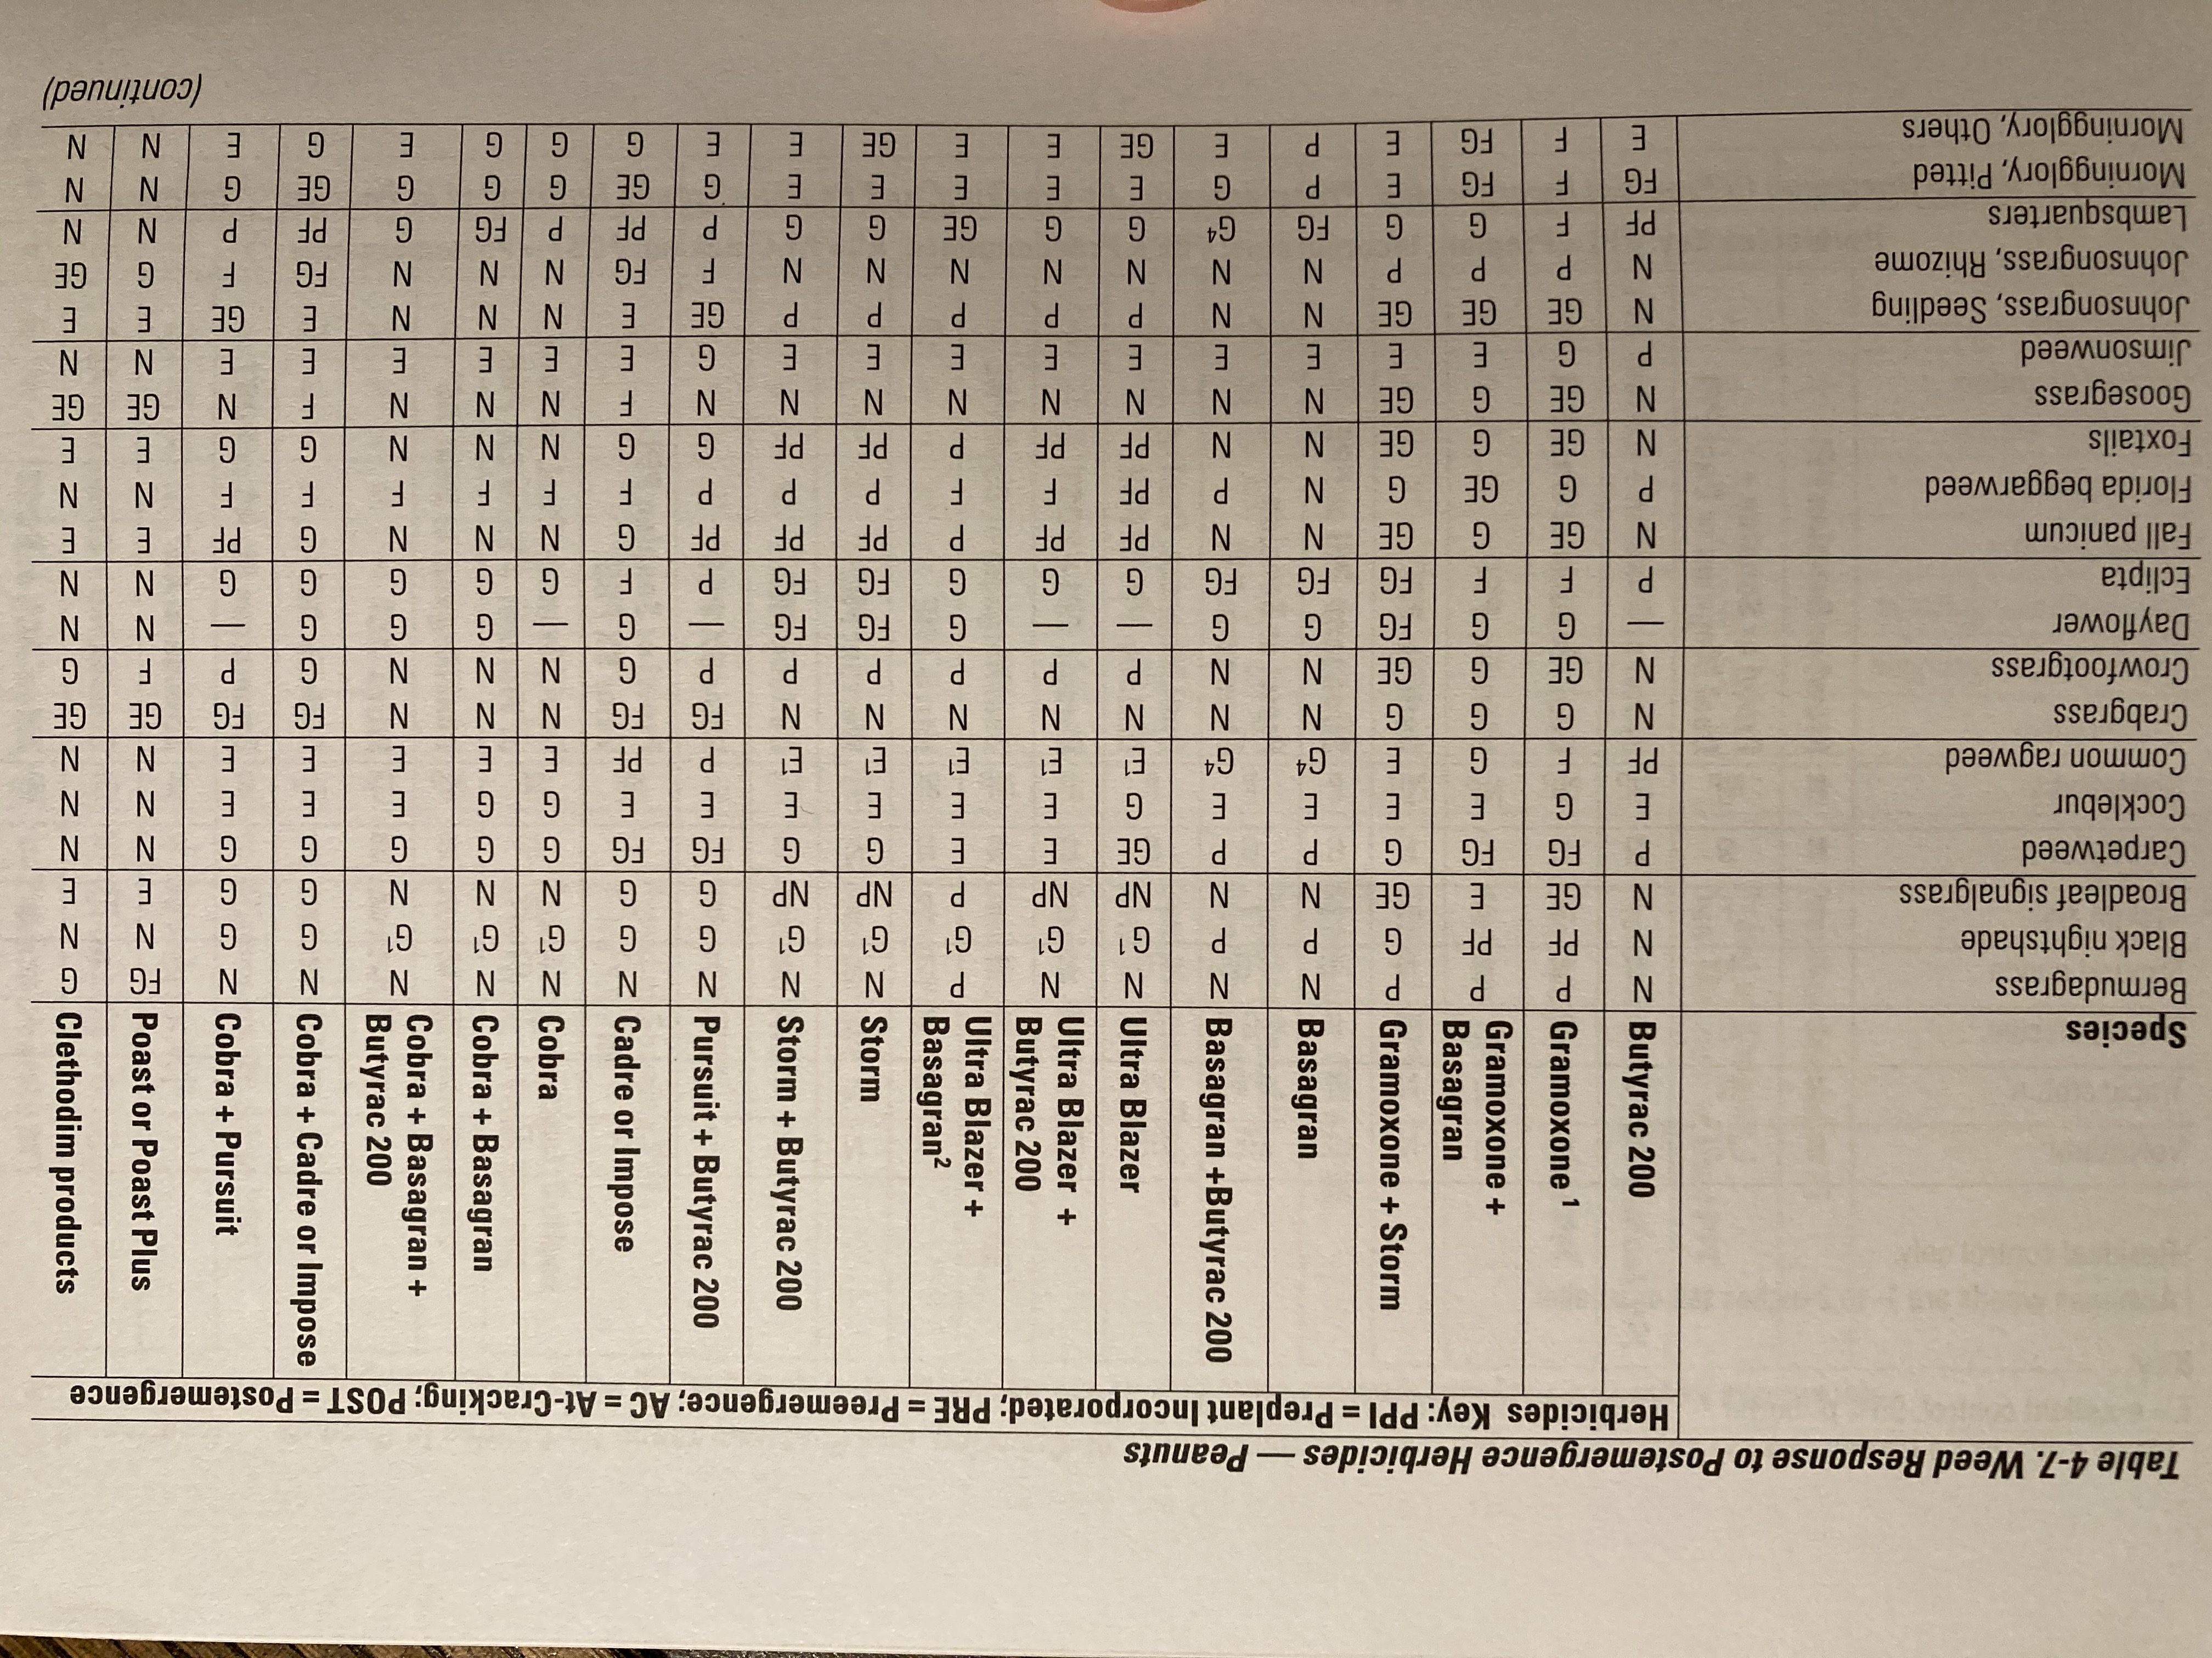

Slide 39
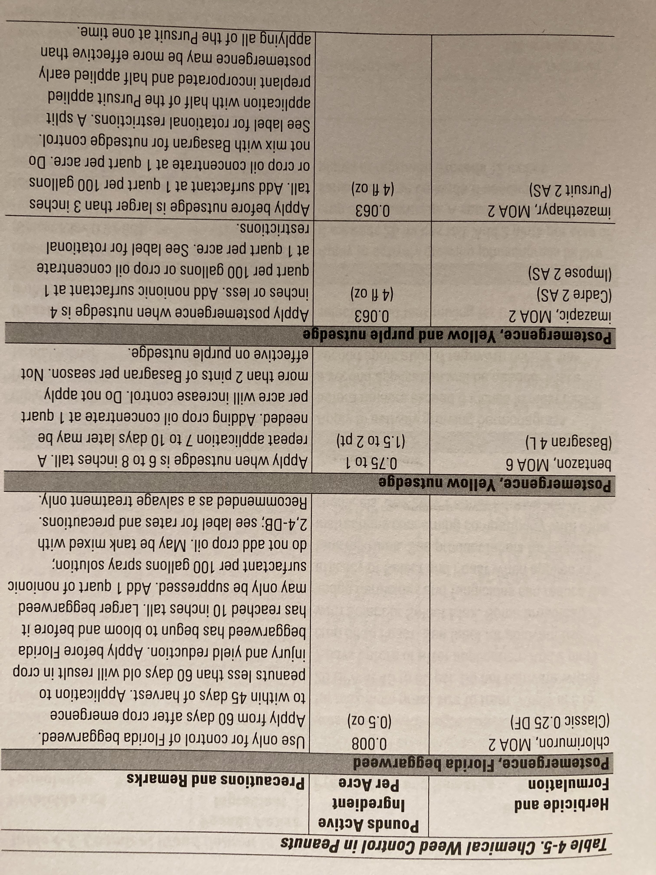

Slide 40
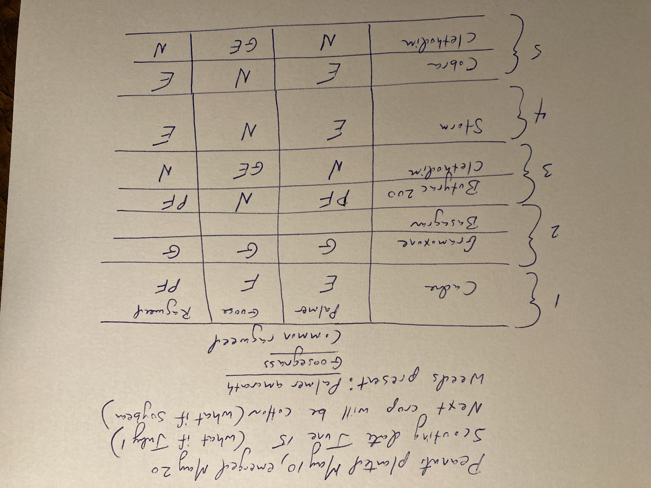

Slide 41
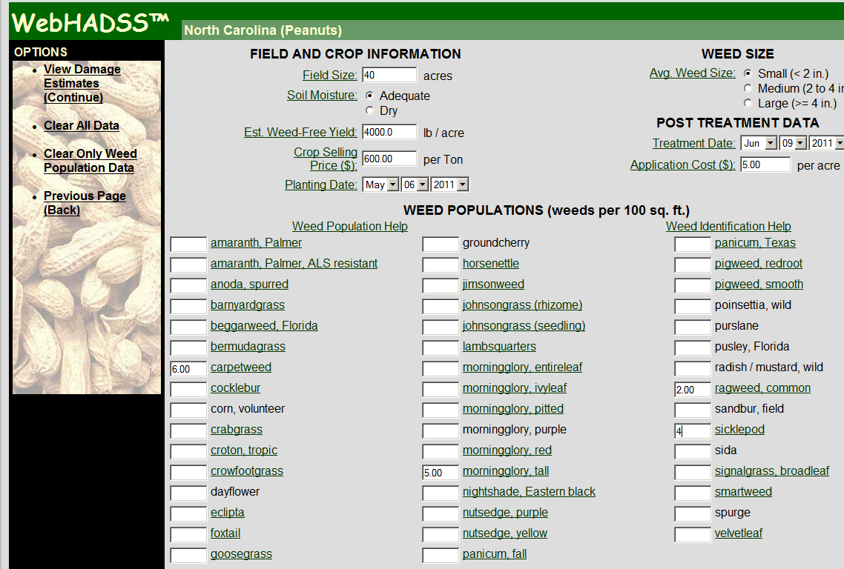

Slide 42
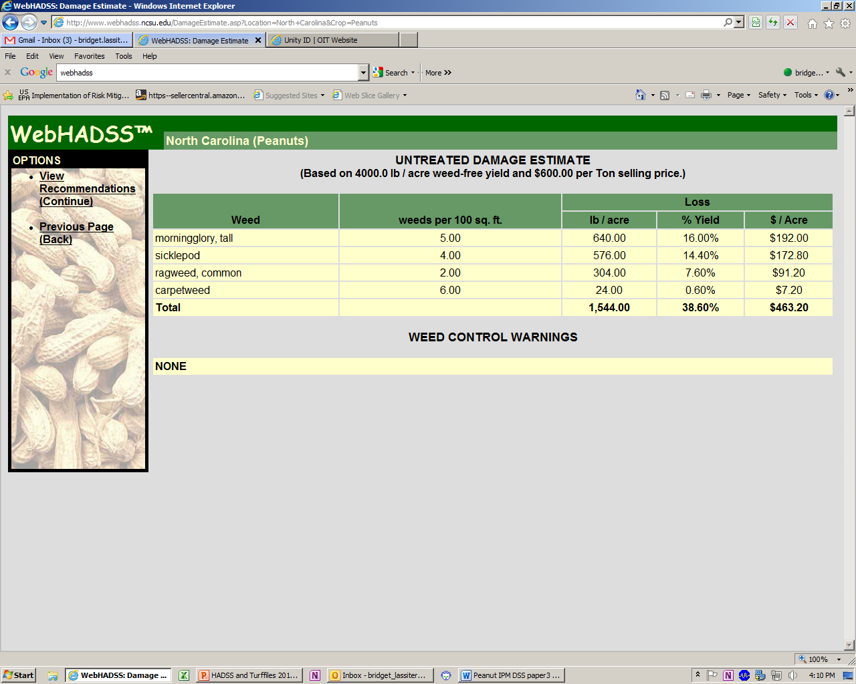

Slide 43
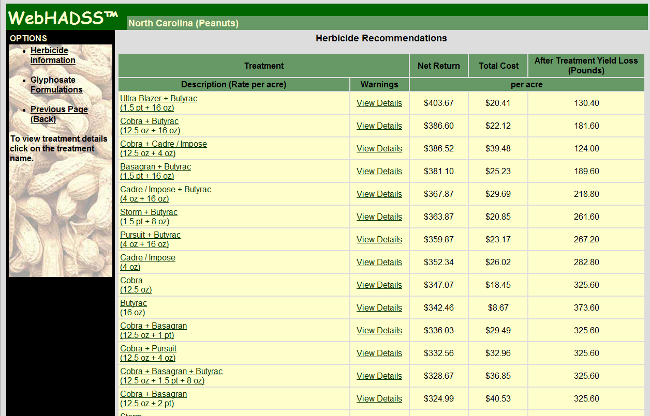
Notes:
43

Slide 44
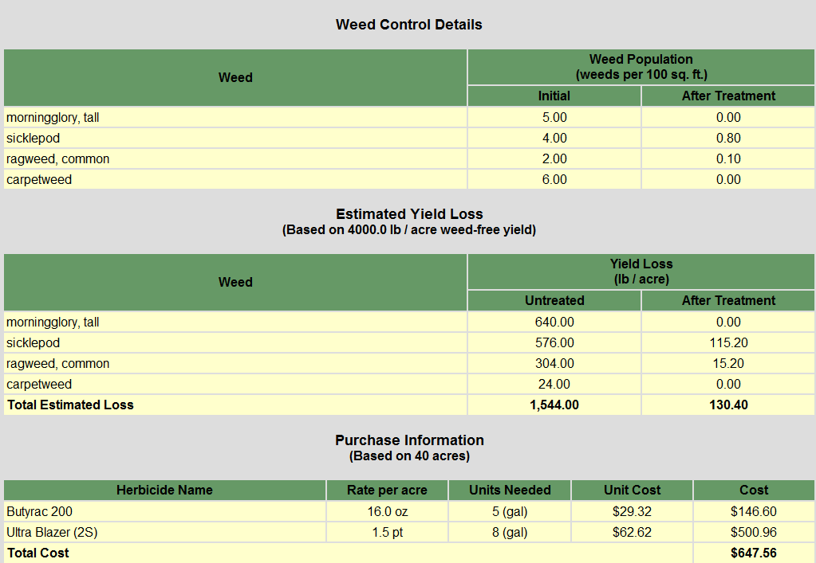
Treatment Details and Weeds Remaining
Notes:
44

Slide 50
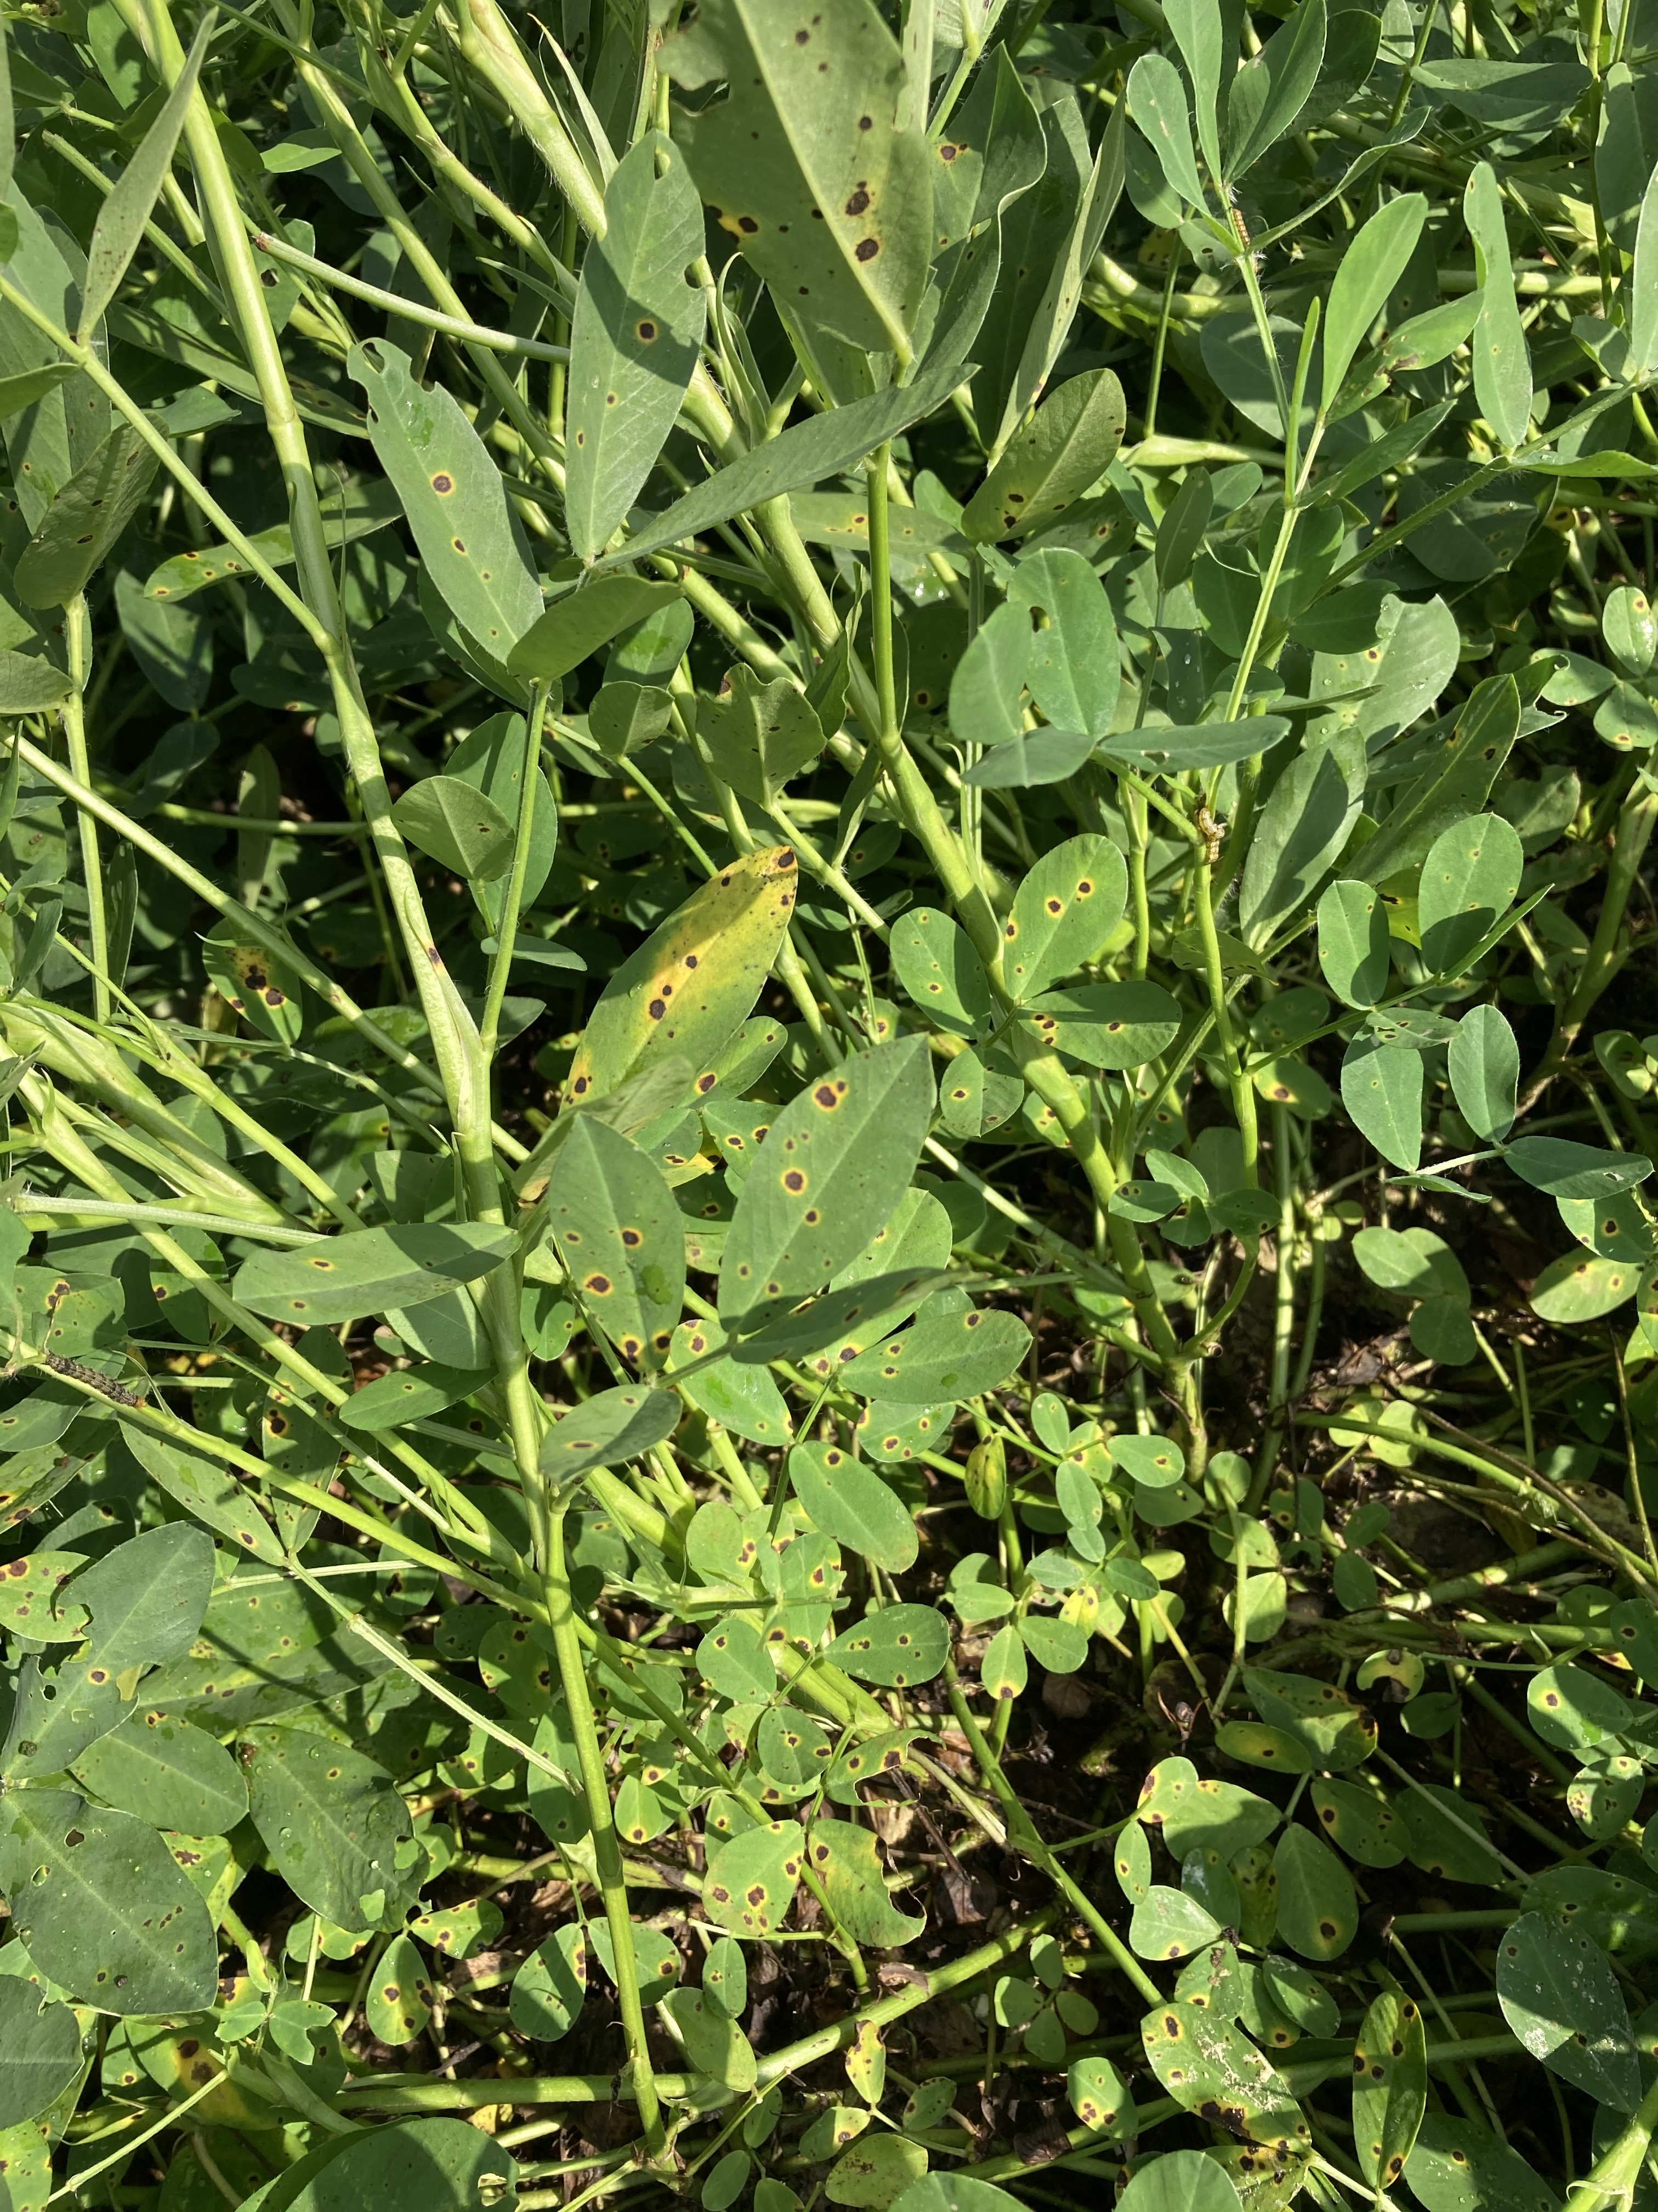

Slide 51
Pathogen Resistance to Fungicides
Pathogen Resistance to Varieties

Slide 54
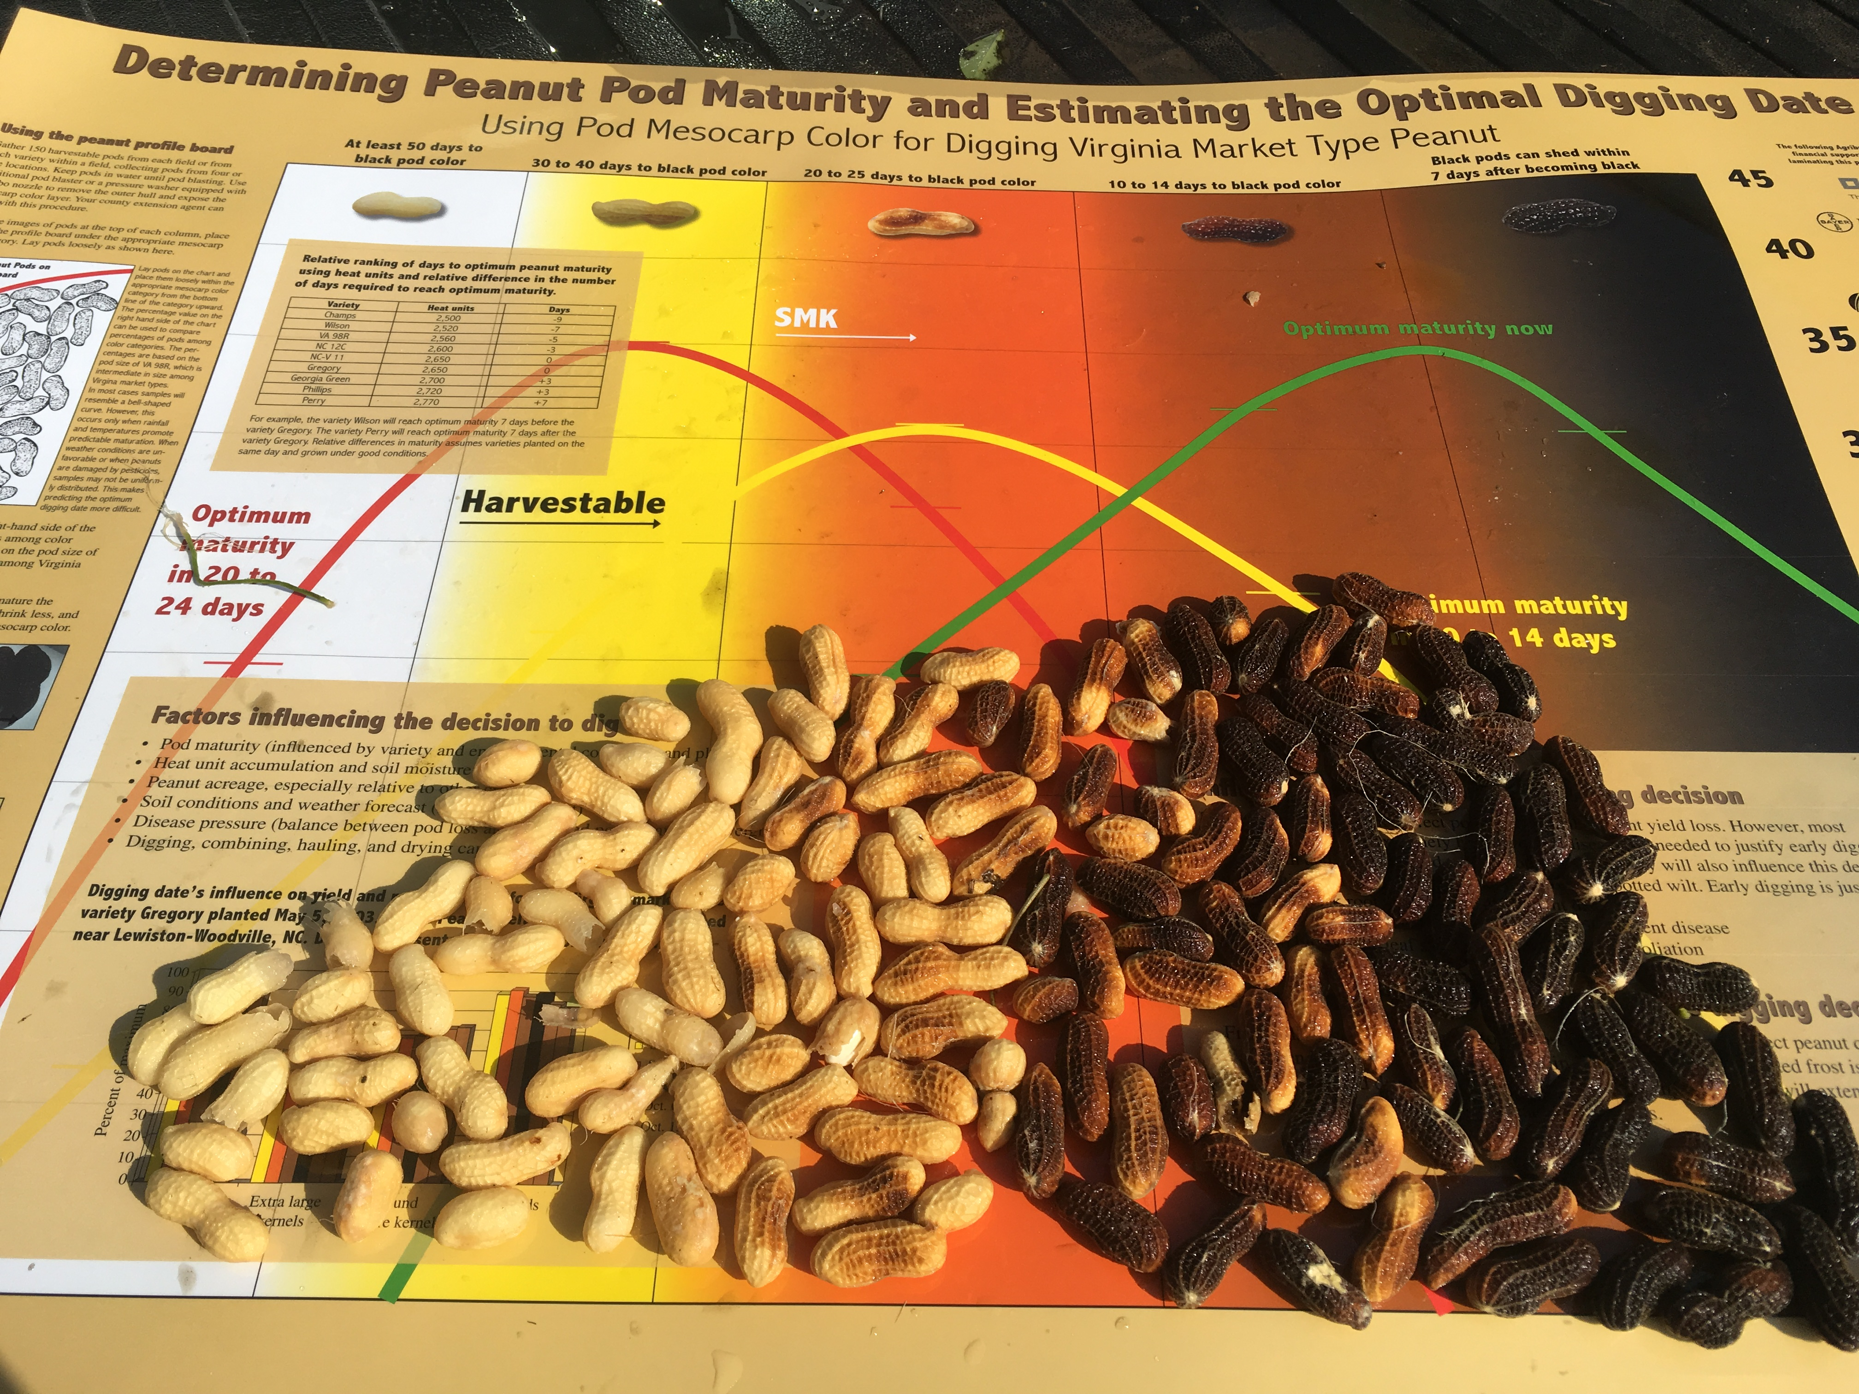
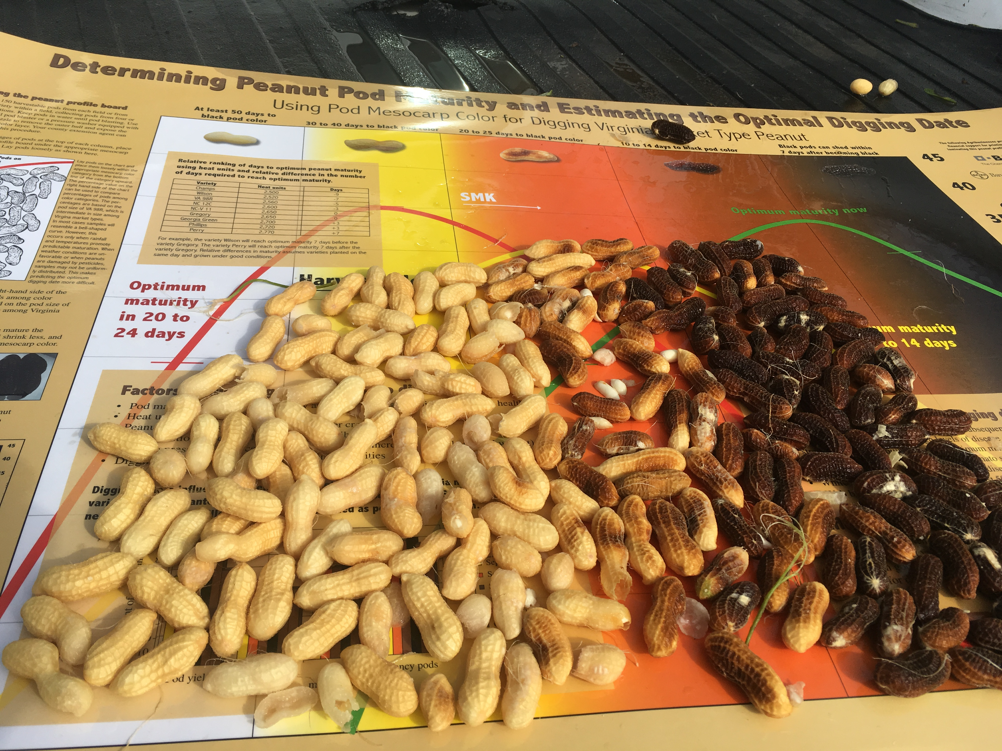
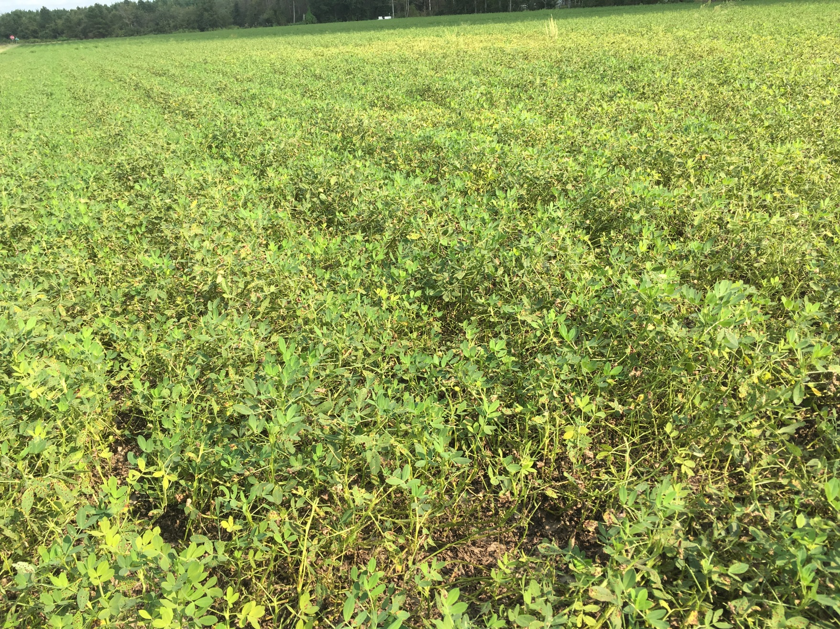
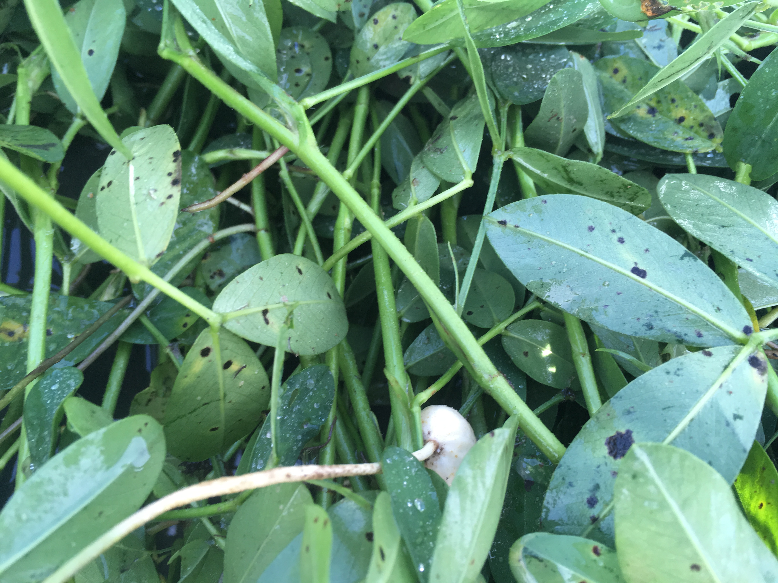
Bailey and Sullivan planted at Whiteville on May 12
Image recorded September 1
Bailey
Sullivan

Slide 55
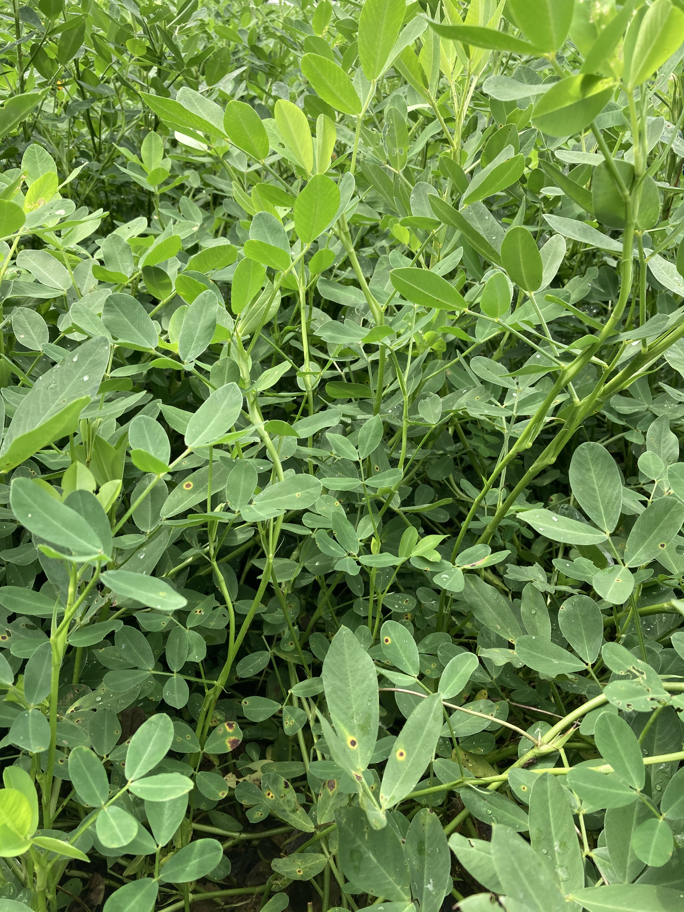
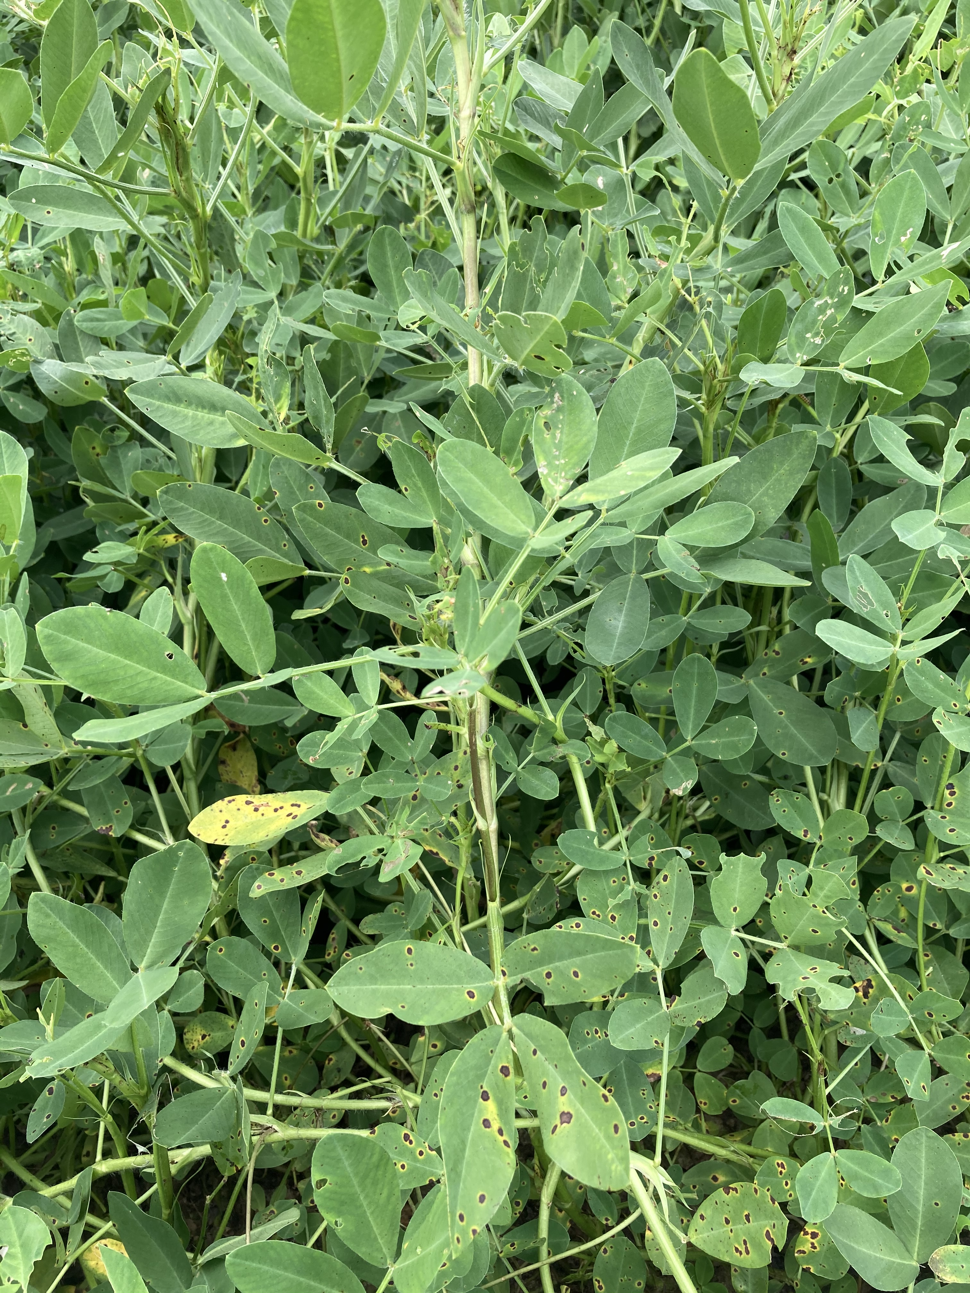
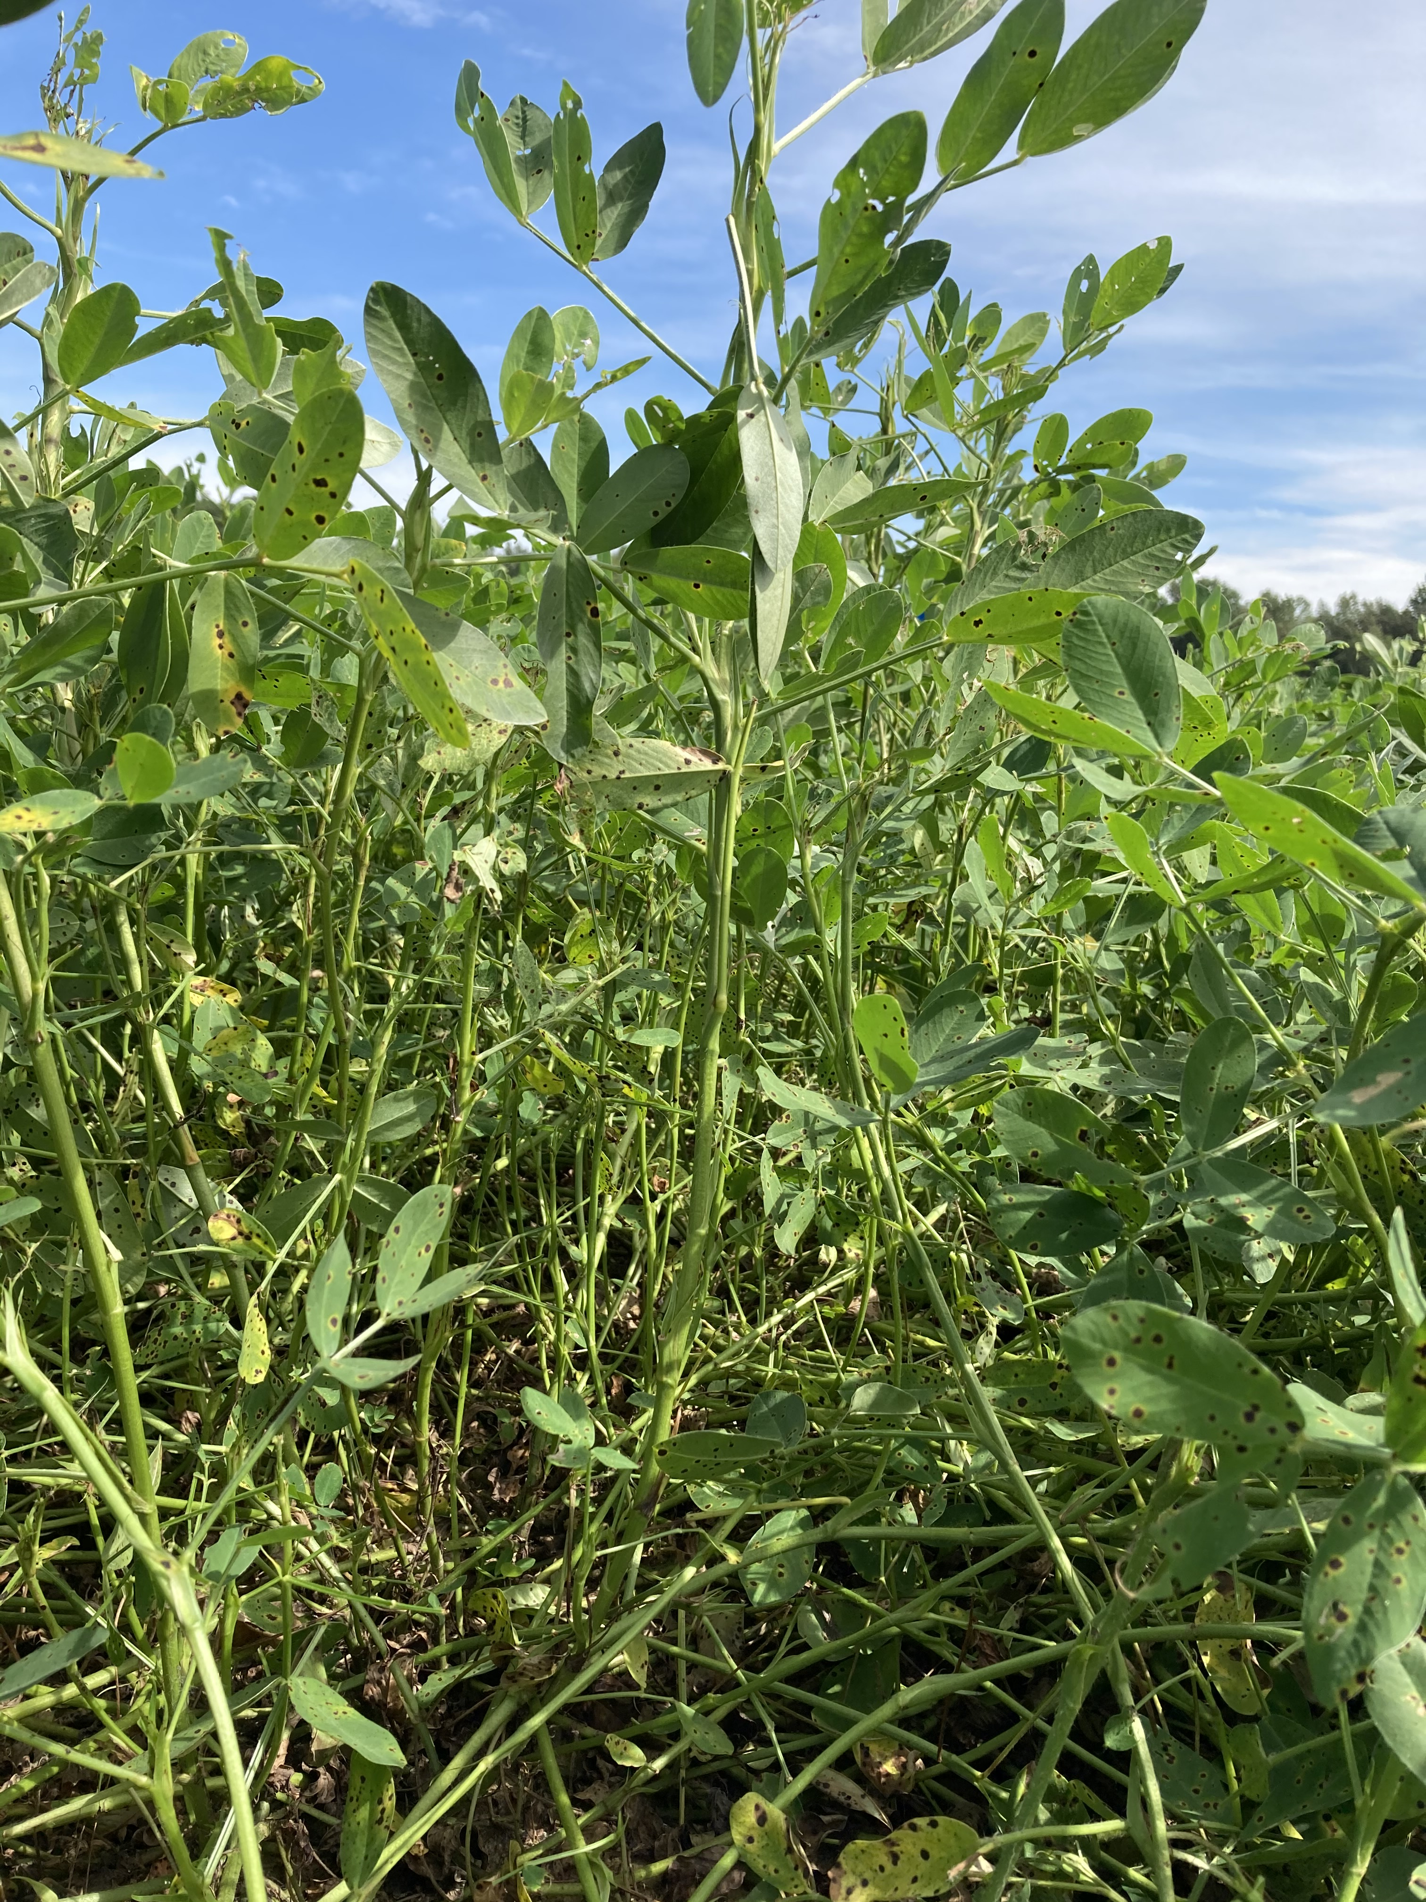
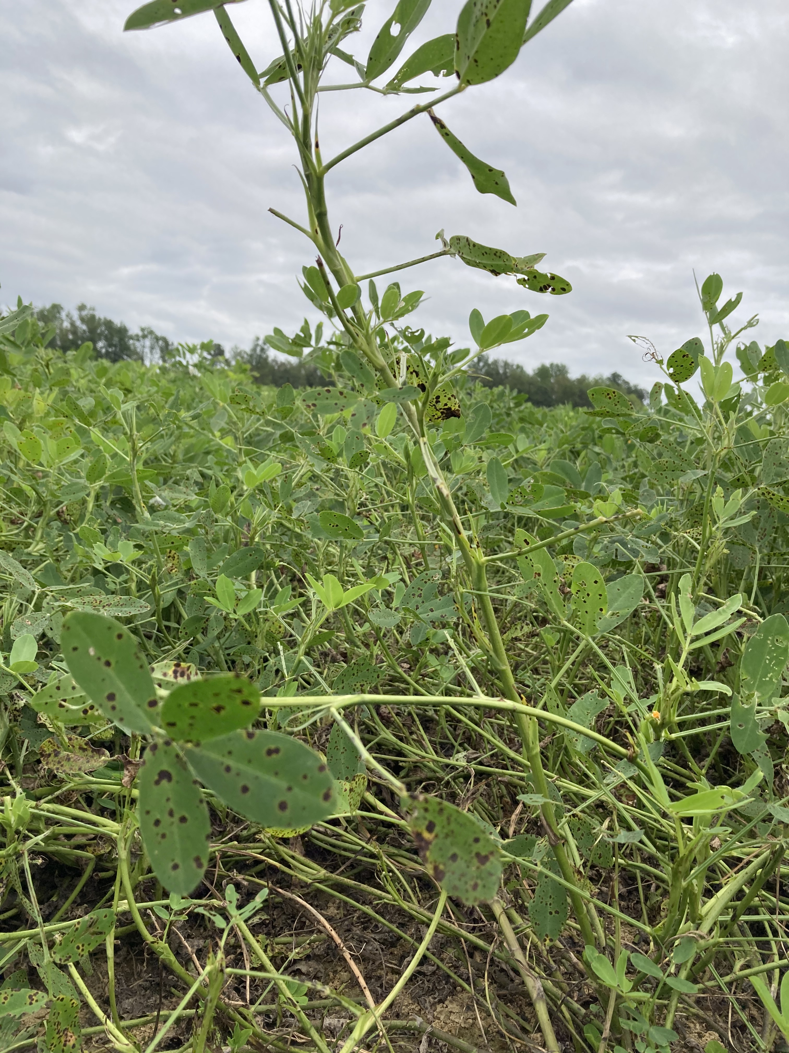
August 23
September 1
September 8
September 16

Slide 56
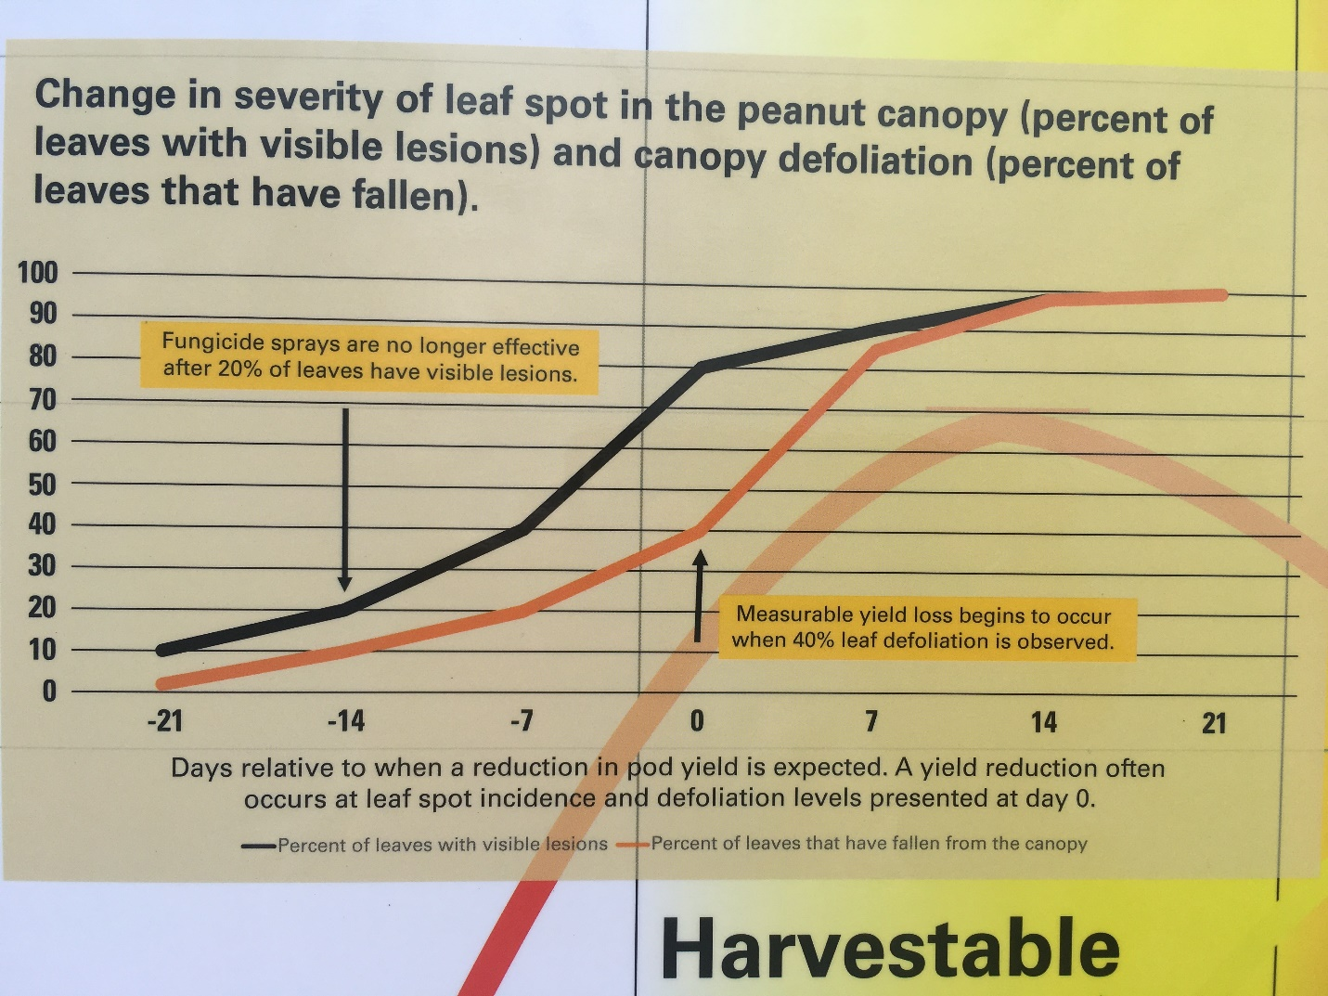

Slide 57
Major Arthropod Pests in Peanut
Tobacco thrips
Southern corn rootworm
Potato leafhoppers
Fall armyworms
Corn earworms
Tobacco budworms
Spider mites
Lesser cornstalk borer
Burrower Bug

Slide 59
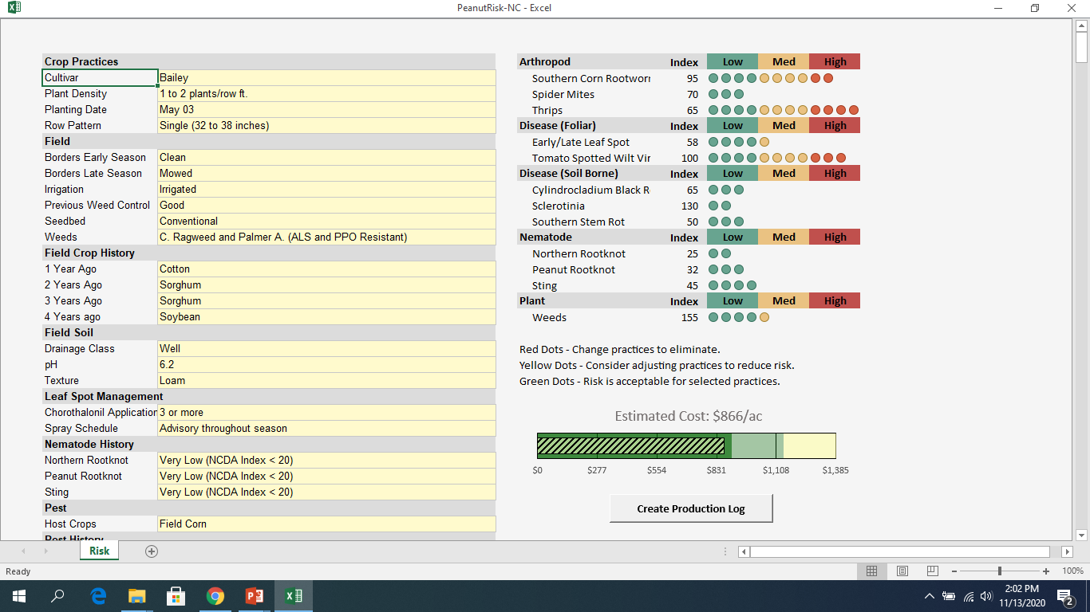

Slide 60
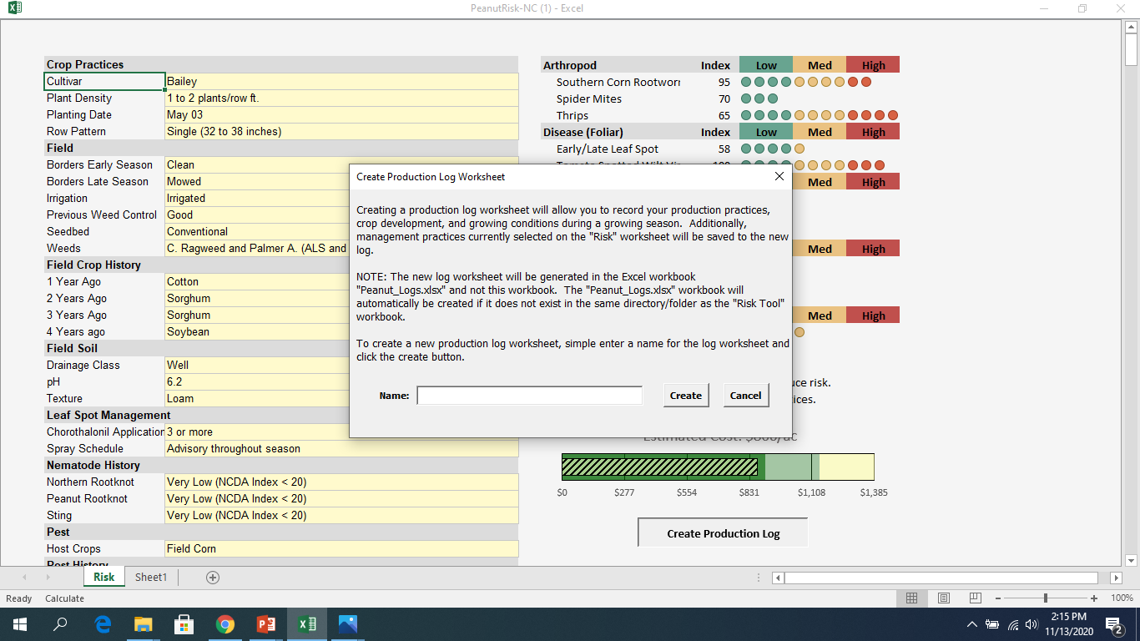

Slide 61
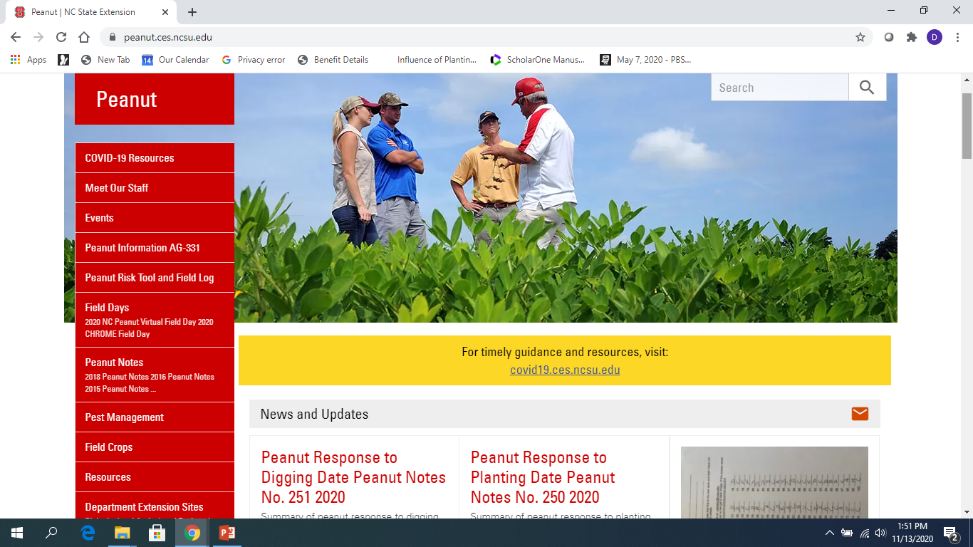

Slide 62
